Slide 1
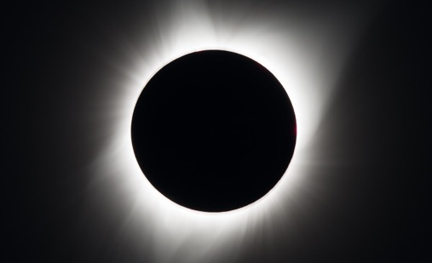
Ready, Set, Total (April 8, 2024) Eclipse!
Dr. Sanlyn Buxner and DaNel Hogan

Slide 2
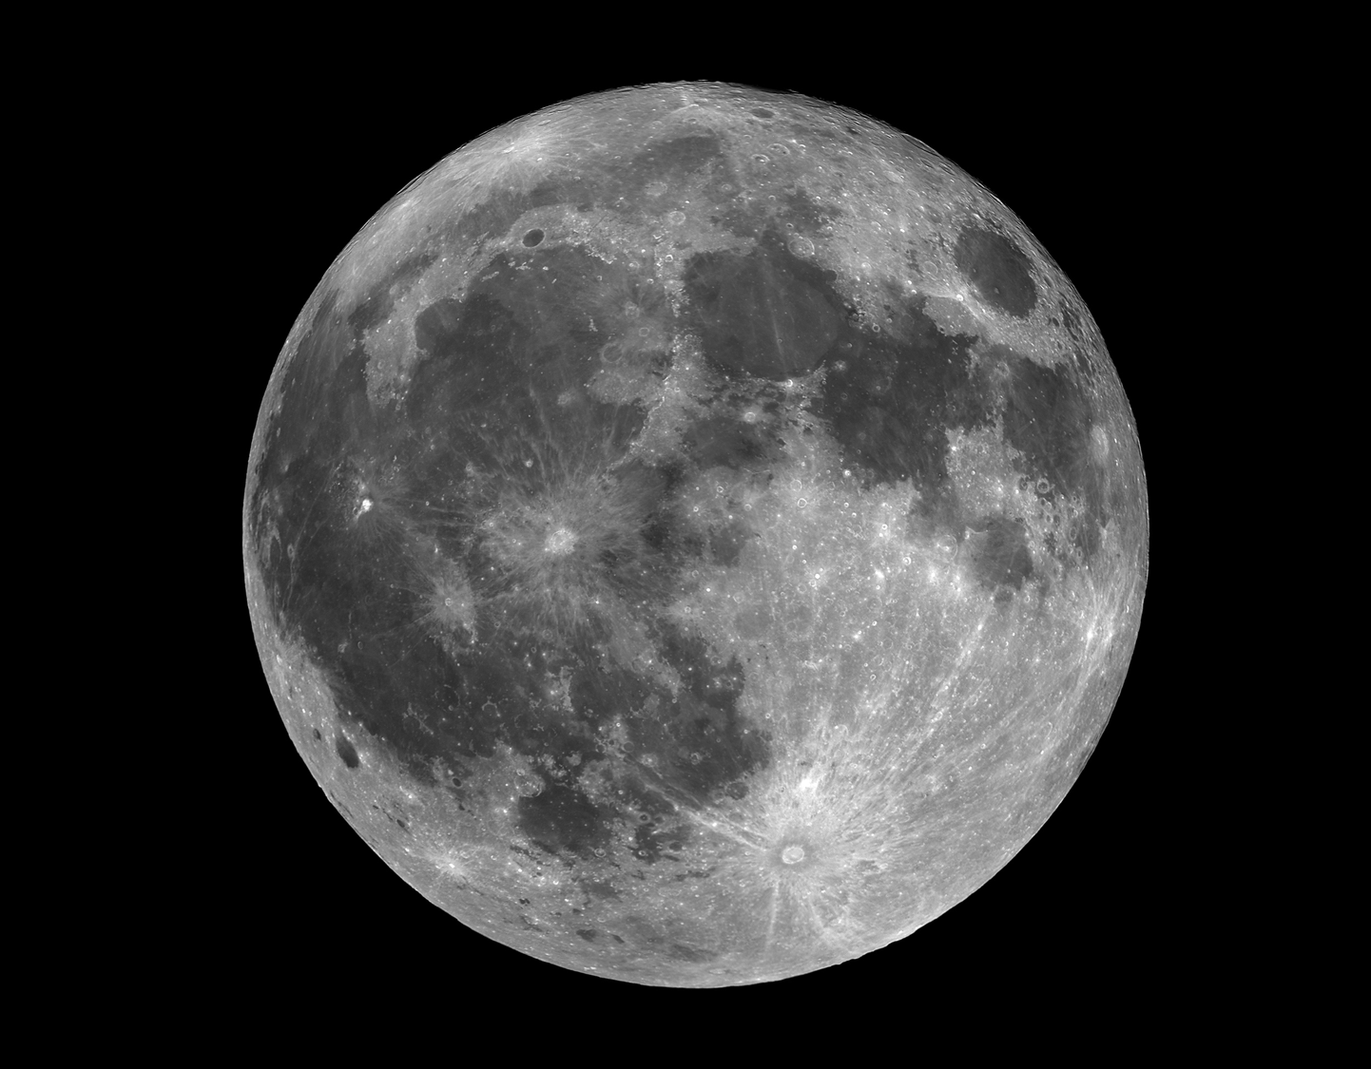

Slide 3
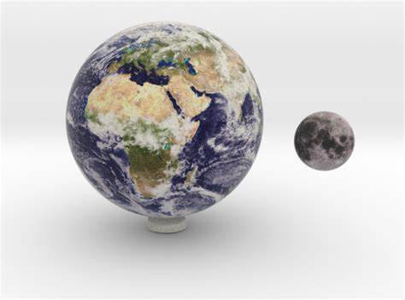

Slide 4
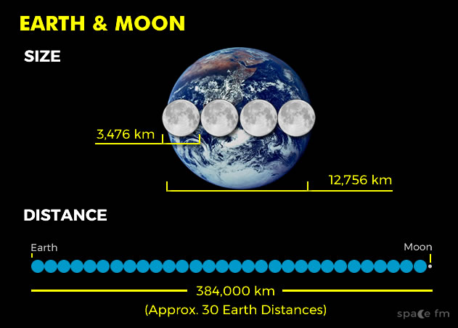

Slide 6
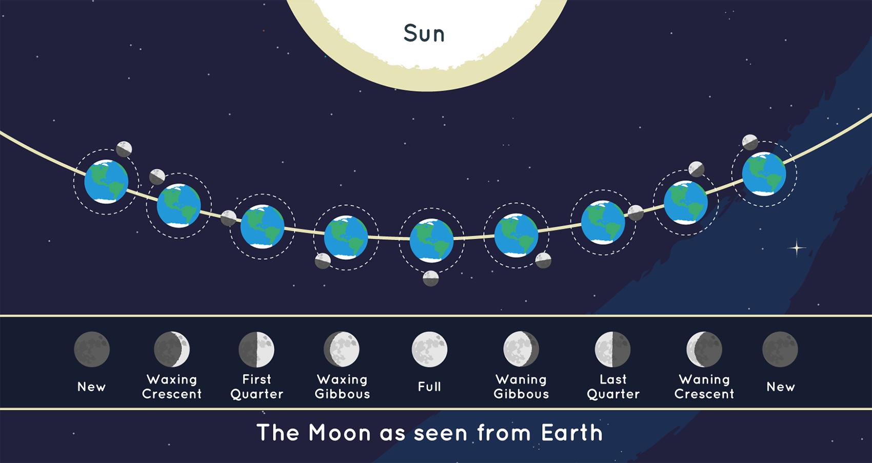
Credit: NASA/JPL-Caltech

Slide 7
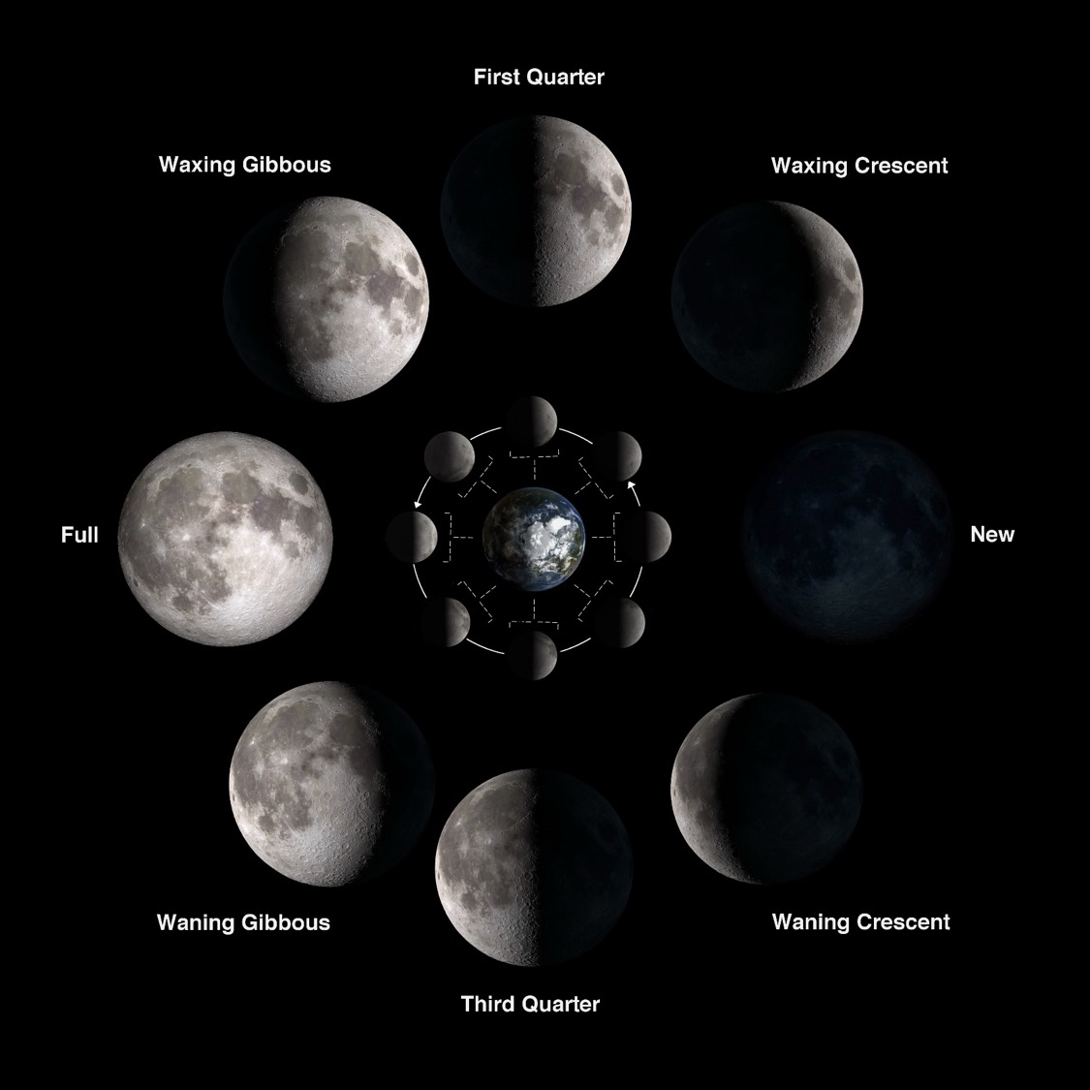

Slide 9
Another look at Moon phases
WGBH Lunar Phases Asset 3 (pbslearningmedia.org)

Slide 10
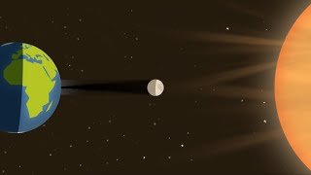
What Is a Solar Eclipse?
Credit: NASA
A solar eclipse occurs when the Moon moves between the Sun and Earth during the New Moon phase, resulting in the Moon casting a shadow onto the surface of the Earth. The Moon will either partially or fully block the light of the Sun.
Notes:
Eclipses only happen occasionally, because the Moon doesn't orbit in the exact same plane as the Sun and Earth.
Eclipses seem rare because the Moon’s shadow is small compared to Earth’s surface, and most of the surface of Earth is covered by water. This means that it is rare that an eclipse will pass over any specific city or location on Earth.
There is an eclipse season. These are times when Earth, the Moon, and the Sun are aligned, which happens twice a year and lasts for about 35 days each. A solar eclipse can only happen during a New Moon. The Moon's orbit is tilted 5 degrees to Earth's orbit around the Sun.

Slide 11
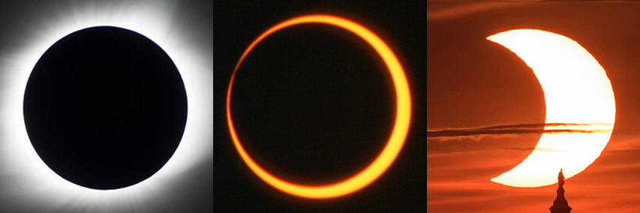
Total eclipse (left): NASA/MSFC/Joseph Matus; annular eclipse (center): NASA/Bill Dunford; partial eclipse (right): NASA/Bill Ingalls

Slide 12
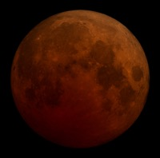
What Is the Difference Between an Annular and a Total Solar Eclipse?
On Saturday, October 14, 2023, viewers will experience an annular solar eclipse. You may also be familiar with a total solar eclipse. We experienced this in the U.S. in 2017 and will experience this again on Monday, April 8, 2024.*
There is a key difference between these solar eclipses. During an annular solar eclipse, the Moon is farther away. It does not block the entire view of the Sun. During a total solar eclipse, the Moon blocks the entire Sun. Find More: solarsystem.nasa.gov/eclipses/2023
Credit: NASA/MSFC/Joseph Matus
Credit: NASA/Bill Dunford
Credit: NASA/Bill Ingalls
From left to right, these images show a total solar eclipse, annular solar eclipse, and partial solar eclipse. A hybrid eclipse appears as either a total or an annular eclipse (the left and middle images), depending on the observer’s location.
There are other types of eclipses called lunar eclipses. Find More: moon.nasa.gov/moon-in-motion/eclipses
Credit: NASA/SVS
*An additional training will be held prior to the 2024 total solar eclipse. That training will cover topics specific to the 2024 total solar eclipse.
Notes:
The Moon happens to be about 400 times smaller than the Sun, but the Moon is also about 400 times closer to Earth than the Sun is. This means that from Earth, the Moon and the Sun appear to be roughly the same size in the sky. The people who see the total eclipse are in the center of the Moon’s shadow when it hits Earth. The sky will darken, as if it were twilight. Weather permitting, people in the path of a total solar eclipse can see the Sun’s corona, the outer atmosphere of the Sun. A total solar eclipse is the only type of solar eclipse where viewers can watch without their eclipse glasses – and they can only remove their glasses when the Moon is completely blocking the Sun.
If you are outside the annular path on October 14th, you may experience a partial solar eclipse. Partial solar eclipses happens when the Sun, Moon, and Earth are not exactly lined up. Only a part of the Sun will appear to be covered. During a total or annular solar eclipse, people outside the Moon’s inner shadow see a partial solar eclipse.

Slide 13
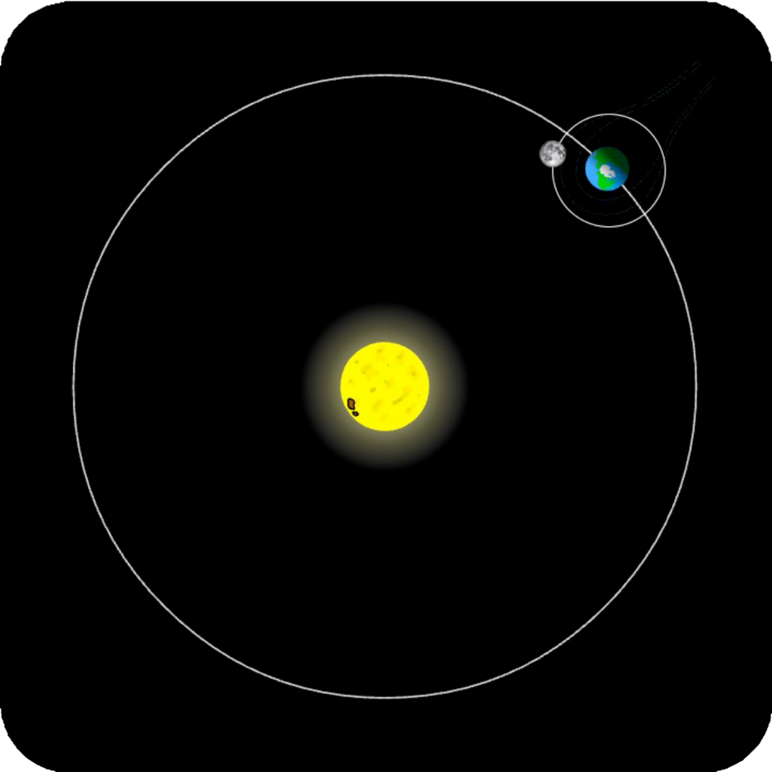
So what’s going on?
The Moon gets in front of the Sun, casting a shadow on the Earth. The end.

Slide 14
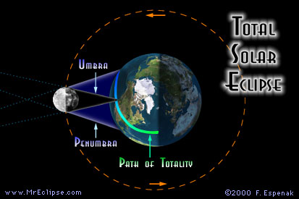

Slide 15
Not so fast.
We have questions!
Why are solar eclipses rare?
Why are there different kinds of eclipses?
What’s the big deal with “totality”?
Is this entire exercise fraught with danger?!

Slide 16
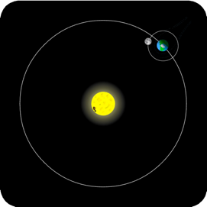
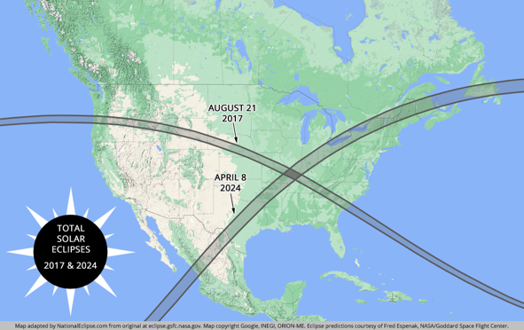
Why so rare?
Moon
(Sun is waaaay off the screen)
Notes:
The scales of that upper right-hand diagram are completely wrong. This line we see here is now the Earth and Moon to scale (size and distance). So in reality, the Moon is about ¼ the diameter of Earth, and should be 30 Earth diameters away. the Sun is 400x further away, and 400x bigger than the diagram in the upper right-hand corner. That puts the sun 40 Earth-Moon distances away (multiply the line on the screen by 40), so you can say something based on room size about where the sun is.
At this scale, you can start to see that the shadow of the Moon on the Earth is very small. The Moon's shadow is only about 200km, 124mi wide. The width of the paths on the map are the size of the Moon’s shadow. Remember too that much of the Earth is water or otherwise uninhabited. The odds of you being under the line is next to nil. Being under a partial is much more likely.
On this map, the width of the lines across the continent equal the width of the Moon's shadow during a total solar eclipse.

Slide 17
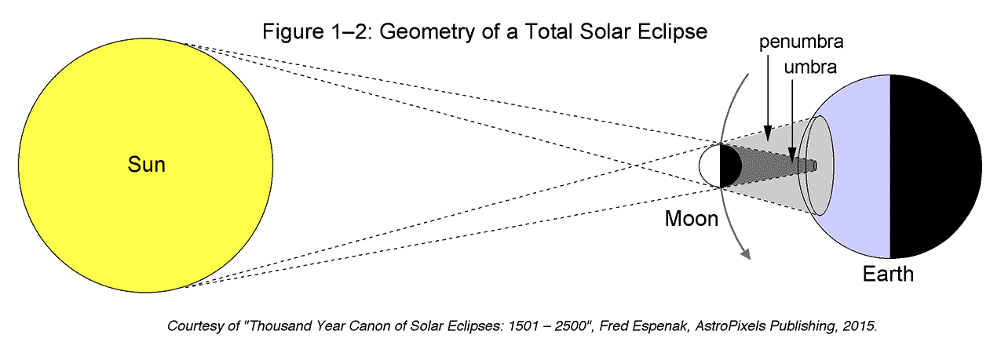
EclipseWise - Solar Eclipse Basics

Slide 18
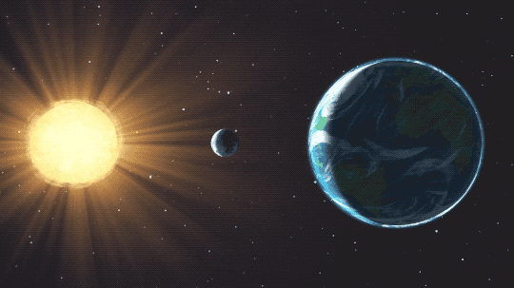
Credit: NASA's Goddard Space Flight Center

Slide 19
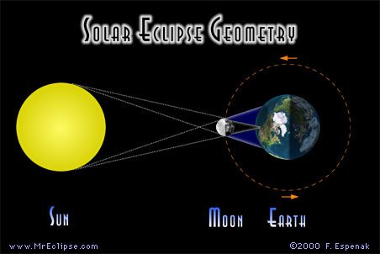

Slide 20
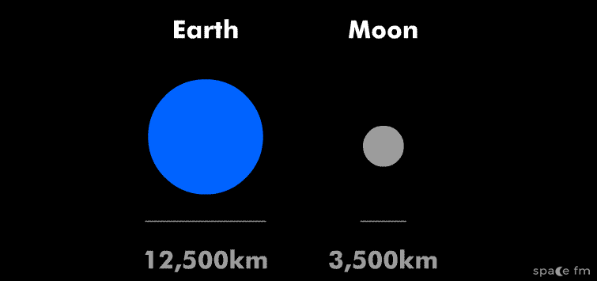

Slide 22
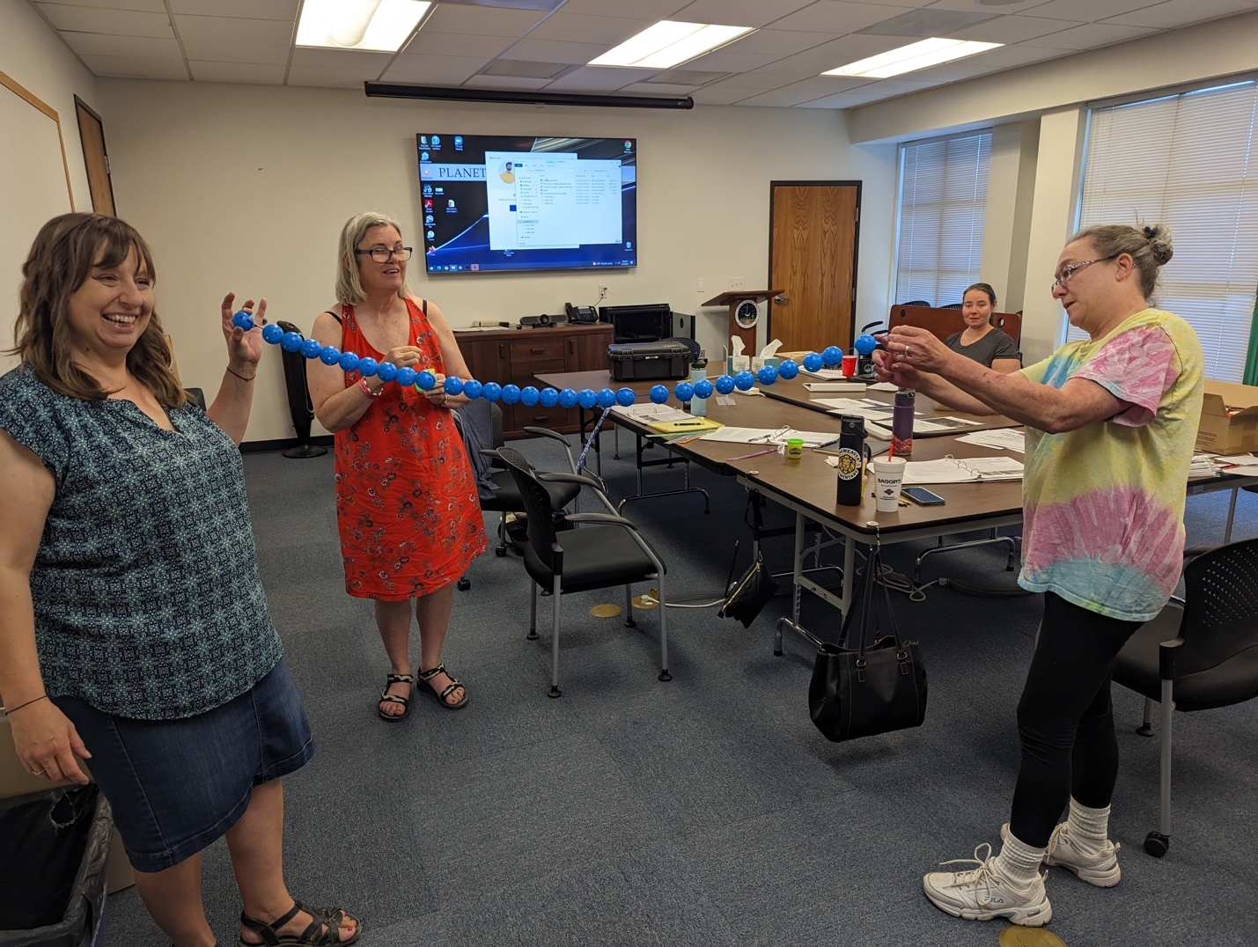

Slide 23
Why not an eclipse every month?
Moon
(Sun is still waaaay off the screen)
Notes:
The Moon’s orbit is tilted just a bit (5 degrees) from the Earth-Sun orbit, so the shadow is likely to miss the Earth most of the time. So to get an eclipse the moon has to cross the Earth’s orbital plane (the ecliptic) at the point when it’s between the Earth and sun (new moon). The shadow has to hit the Earth and hit where you happen to be. On average a given spot on the Earth will only see a total eclipse once every 350 years.

Slide 24
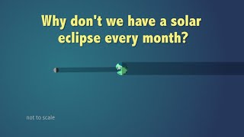
Why Isn’t There an Eclipse Every Month?
This animation illustrates how the tilt of the Moon’s orbit often keeps it out of alignment with the Sun and Earth, preventing frequent eclipses. Credit: NASA
Notes:
Remember that for an eclipse to occur the Sun, Moon, and Earth need to be a direct line. The Sun is the center of the solar system with all planets orbiting around it, including Earth. The Moon is orbiting around Earth.

Slide 26
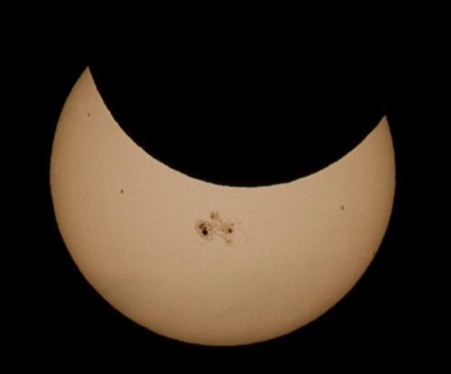
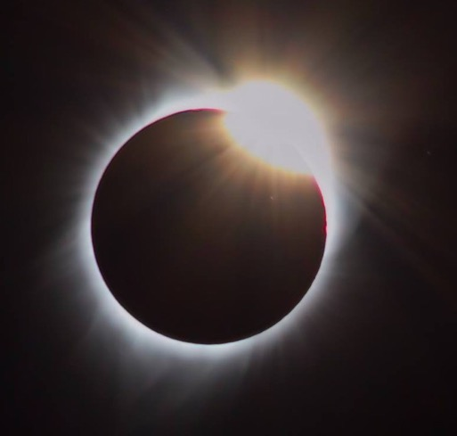
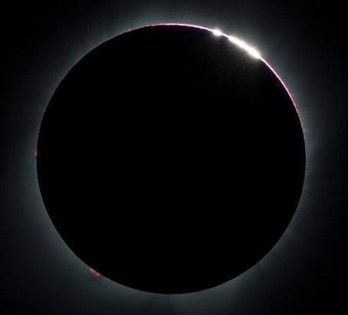
What will we see on April 8th, 2024?
Partial (with sunspots?)
Diamond Ring
Bailey’s Beads
Totality… glasses off!
Notes:
Everybody gets a partial eclipse! Partials can last an hour or two on either side – you can plan eclipse programs/activities during this time
The diamond-ring effect occurs at the beginning and end of totality during a total solar eclipse. As the last bits of sunlight pass through the valleys on the moon's limb, and the faint corona around the Sun is just becoming visible, it looks like a ring with glittering diamonds on it.
Bailey's beads – what do you think causes this phenomena? As the Moon covers the Sun during a solar eclipse, the rugged topography of the lunar limb allows beads of sunlight to shine through in some places while not in others.
Sunspots from 2014 partial, JH. Ring from 2017 total, JH. Beads NASA/Aubrey Gemignani, 2017. https://www.nasa.gov/image-feature/the-bailys-beads-effect-during-the-2017-total-solar-eclipse

Slide 27
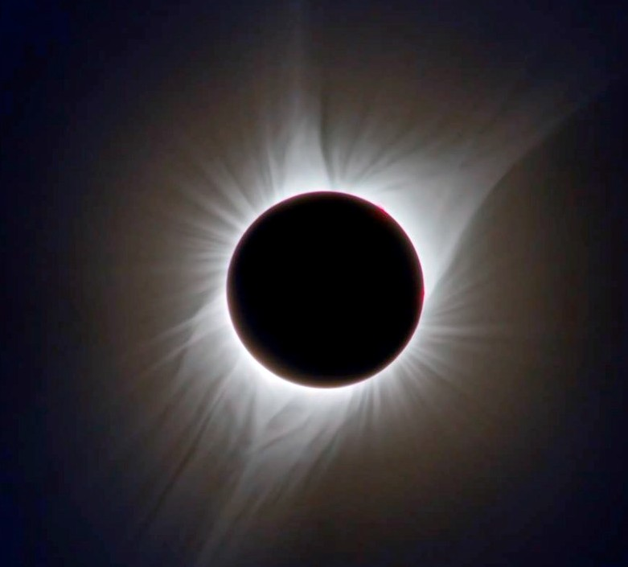
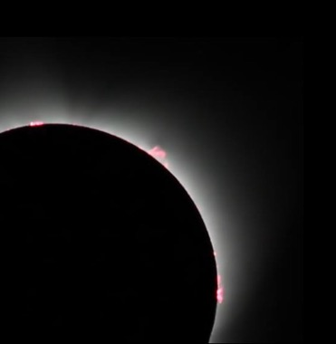
What’s so special about totality?
See the Sun’s atmosphere: the solar corona.
The Sun is 400,000 times brighter than the corona. (Even 99% of an eclipse is too bright to see the corona)
Totality is the only time you can (and should!) take off your eclipse glasses to look at the Sun.
Hot gases move along the Sun's magnetic field, tracing its complex structure.
Solar prominences arch above the Sun’s surface.
Notes:
Images by JH
Plasmas move along magnetic field lines – and the Sun has a huge magnetic field, so you can see the plasmas moving during totality.

Slide 28
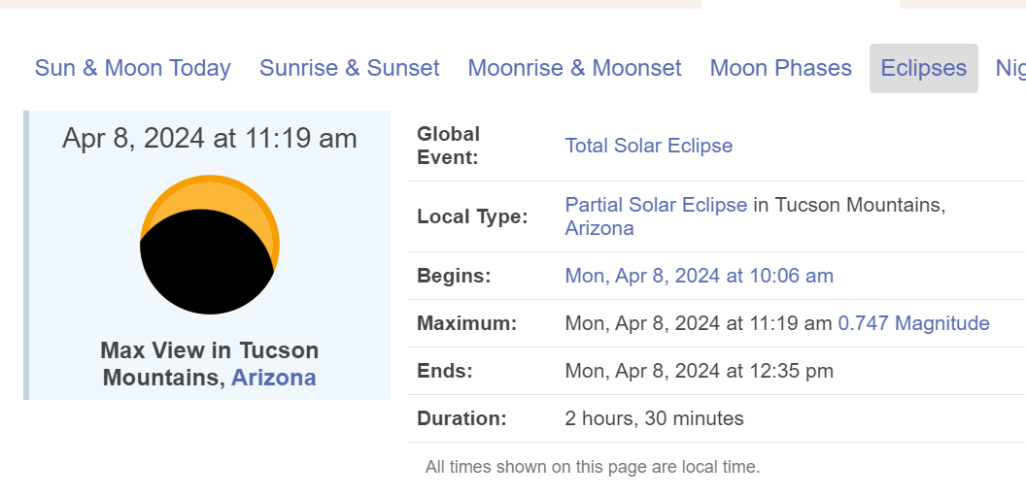
April 8, 2024– Eclipse as soon by Tucson, AZ
Credit: timeanddate.com
Eclipses visible in Tucson, Arizona, USA – Apr 8, 2024 Solar Eclipse (timeanddate.com)

Slide 29
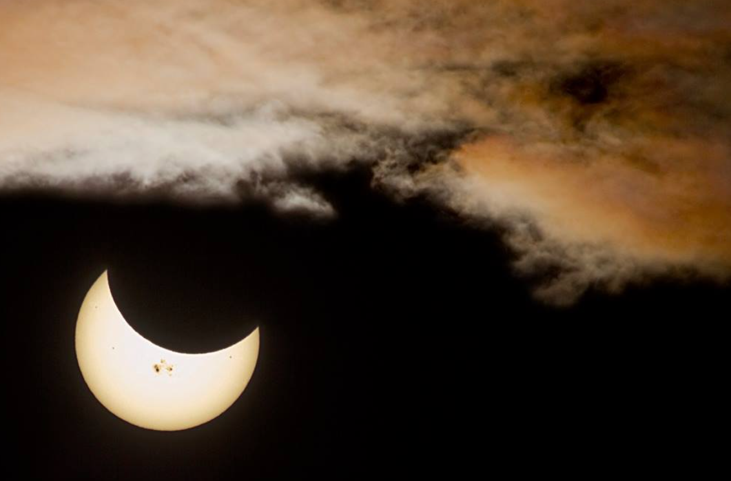

Slide 30
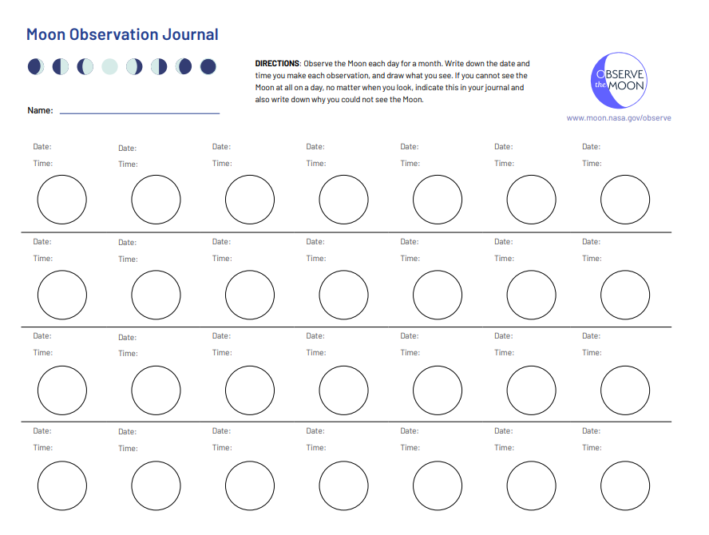

Slide 31
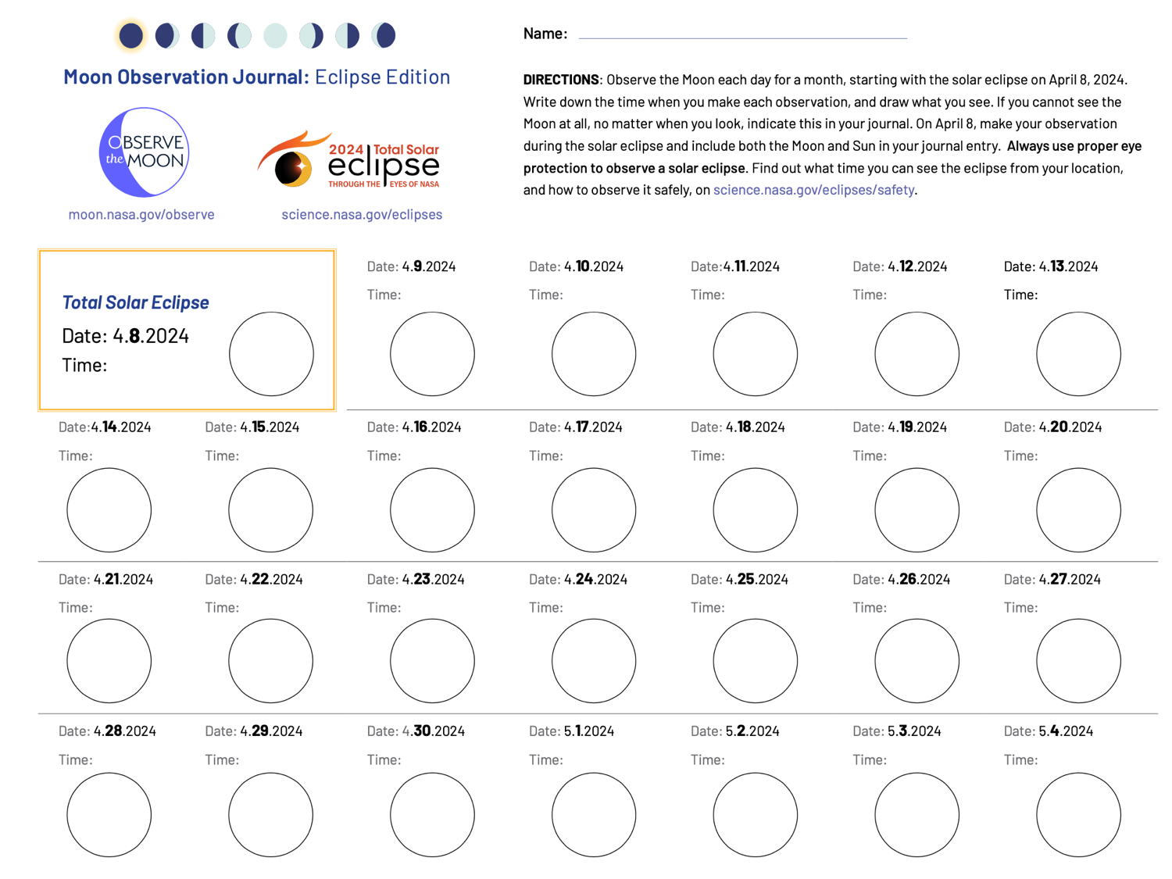
Notes:
Moon Observation Journal - 2024 Eclipse Edition - Moon: NASA Science

Slide 32
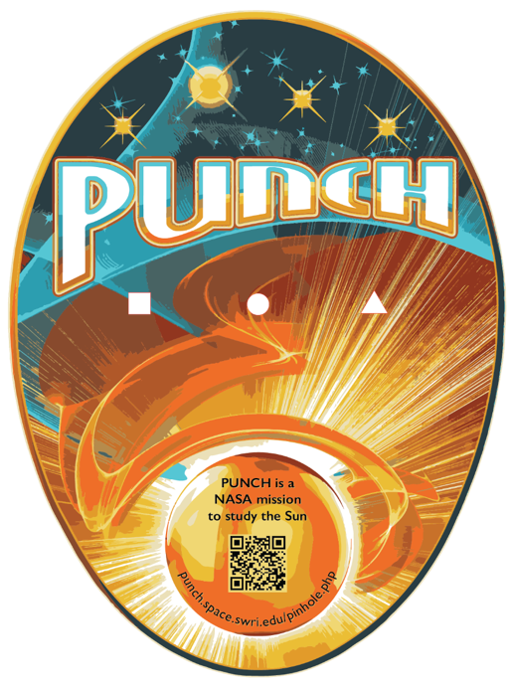
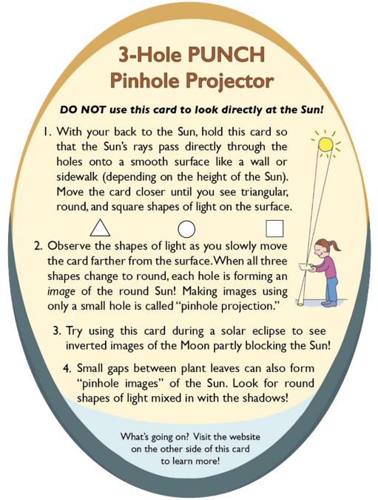
Introducing the
3-Hole PUNCH Pinhole Projector
6 inches
(~15 cm)
FRONT
BACK
The NASA PUNCH Outreach team has developed the 3-Hole PUNCH Pinhole Projector so you can have fun exploring how small, non-round holes can project real images of the round Sun. This can be done on any sunny day, not only when the Sun is eclipsed by the Moon!
Notes:
- Southwest Research Institute, Planetary Science Directorate (swri.edu)

Slide 33
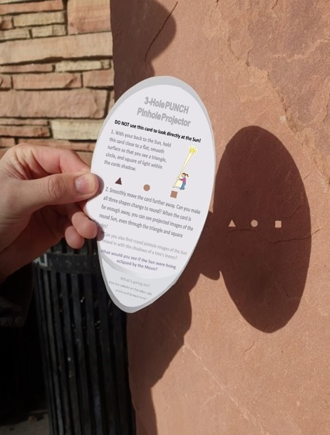
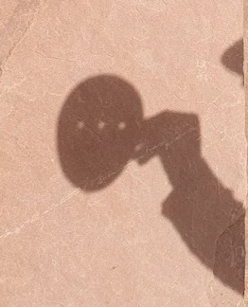
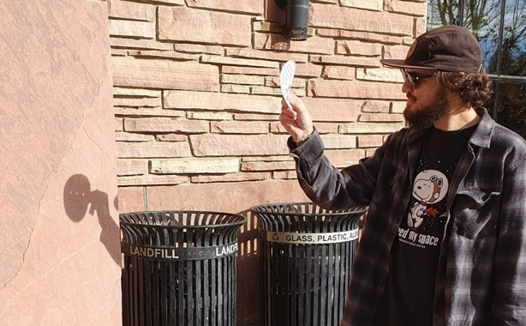
1. Projector close to surface
2. Projector farther away from surface. All three shapes of light are round and fuzzier.
Case 1
Smooth flat
projection surface
Case 2
Outreach for the NASA PUNCH mission
Image of round Sun through square hole
Sunlight comes from this direction and passes thru the holes
square shape of light
KEY QUESTION: Why don’t we see round images of the Sun when the projector is held closer to the projection surface (Case 1), but we do see them when we move it farther away (Case 2)?
JO is observing in the morning in Dec

Slide 34
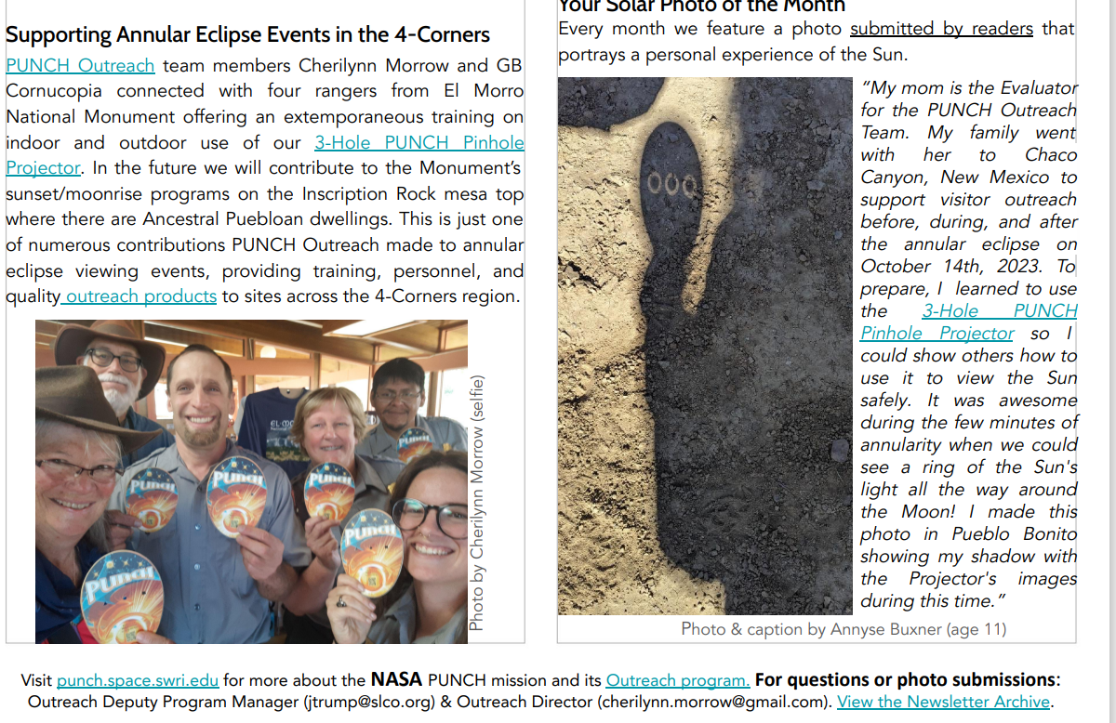

Slide 35
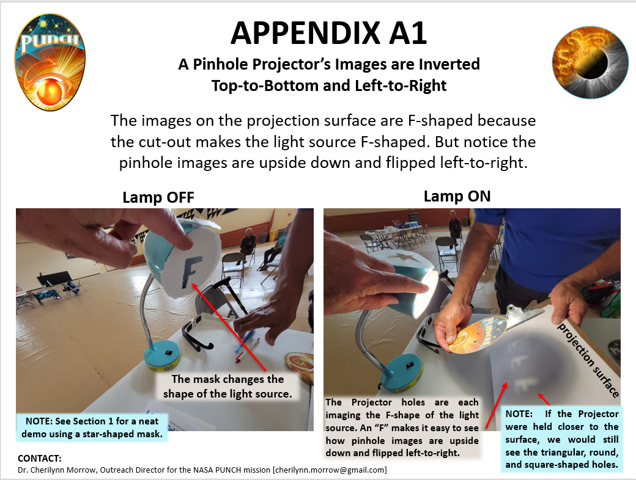

Slide 36
Pinhole Projection of the Sun
Use a fence, a wall, sidewalk, or paper for the projection surface depending on the time of day and how high the Sun is in the sky.
Outreach for the NASA PUNCH mission
Projecting on a vertical fence with morning sunlight
Projecting on a sidewalk with midday sunlight
Can you find the shadow of the cell phone camera? Can you tell where the photographer is located?
8th graders at the Haak’u Community Academy at the Pueblo of Acoma invented a palms-up approach.
Can you find other ways to make pinhole
images of the Sun using your hands?
Try one palm up and the other facing down?

Slide 37
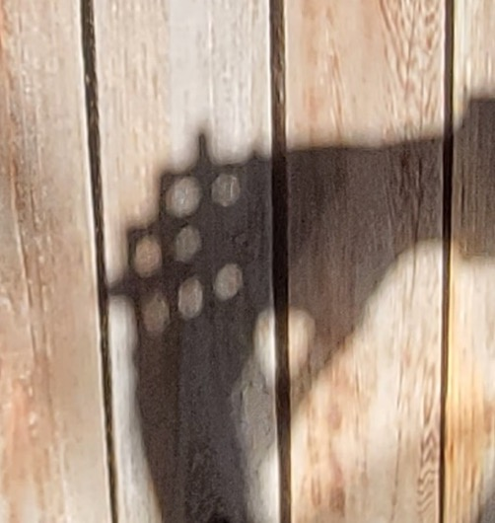
Pinhole Projection of the Sun
Look closely at the back of the hands.
What shapes are the gaps between the crossed fingers? Are they round?
Gaps between crossed fingers are like the holes in the pinhole projector,
What do you think would happen to the images of the round Sun if the hands were moved closer and closer to the fence? Would the shapes of light between the fingers stay round?

Slide 38
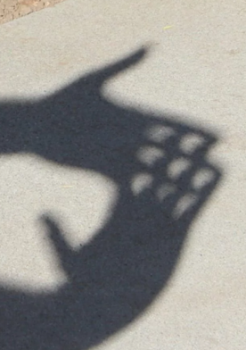
Pinhole Projection of the Sun
Observing the 2017 solar eclipse using a simple pinhole projector with a single square hole and also with crossed fingers
Outreach for the NASA PUNCH mission
Pinhole images of the Sun being eclipsed by the Moon

Slide 39
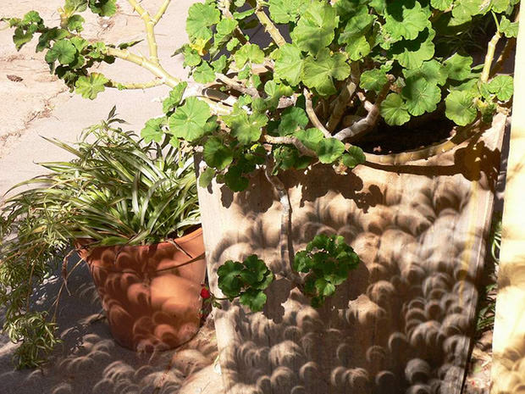
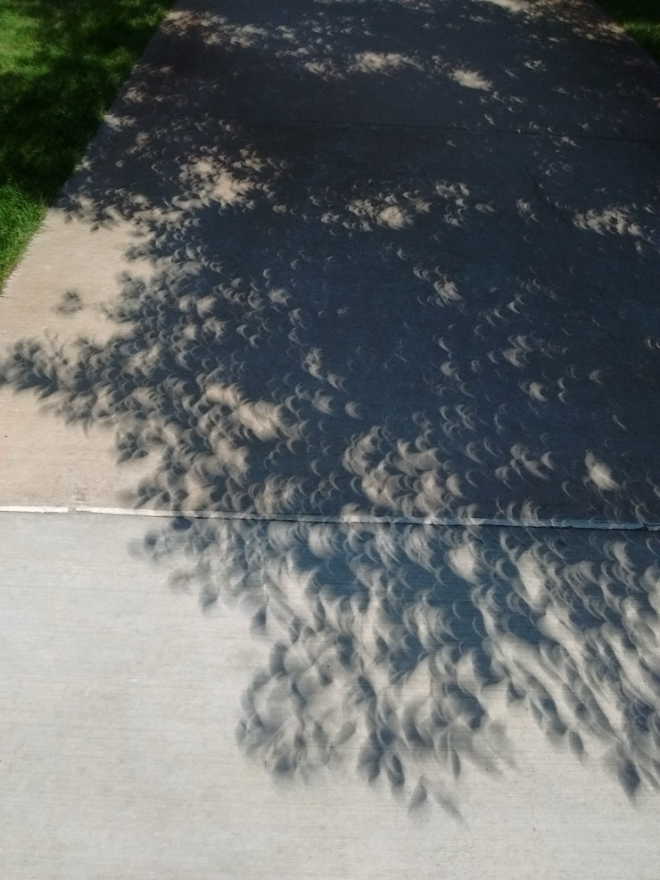
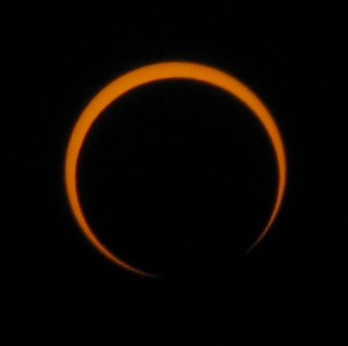
During solar eclipses it is easier to tell that we are seeing real pinhole images of the eclipsed Sun among the shadows of leaves.
Gaps between tree leaves make wonderful pinhole image displays as the Moon eclipses the Sun.
Upper left image by Cantavestrella. See Credits & Acknowledgements.

Slide 40
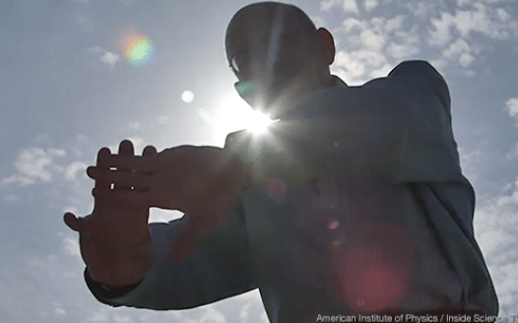
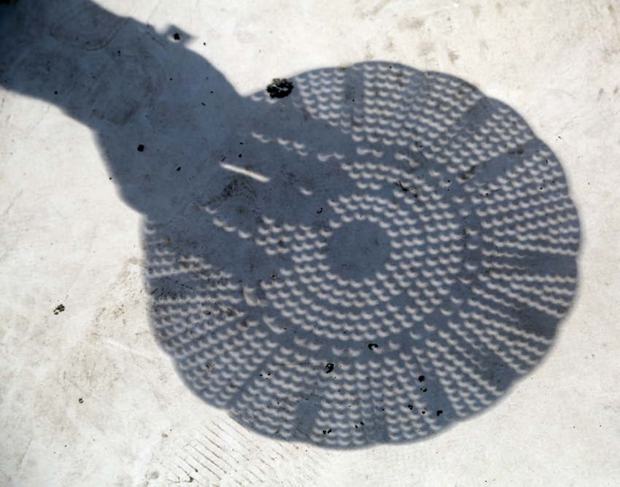
More Safe Indirect Viewing Methods
If you do not have eclipse glasses or a pinhole projector, you can improvise other safe indirect viewing methods.
Pull out a colander from your kitchen, and with the Sun to your back, watch the projections of the eclipse on the ground.
Credit: AAS
Project images of the Sun using your hands.
Credit: NASA/Joy Ng
Notes:
If you don't have eclipse glasses or a pinhole projector, you can use improvised safe indirect viewing methods. For example, you can use a colander to project the eclipse on the ground or use your hands to project images of the Sun, making sure the Sun is behind you.

Slide 41
Solar Safety Glasses
Never use eclipse glasses that aren’t fully certified. Our Eclipse Shades® are "CE" Certified, meeting standards for transmission for scale 12-16 of EN 169/1992 for safe solar viewing. They’re also certified to meet ISO standard 12312-2:2015. They also meet the 2012 Transmission Requirements of EN 1836:2005 and AS/NZS 1338.1:1992 for eclipse filters (Queensland Directive).
Made in the USA and trusted by NASA and AAS, our eclipse safety glasses and viewers have scratch-resistant lenses with optical density 5+ to ensure complete protection from solar radiation. Our “Silver/Black Polymer” blocks out 99.999% of intense visible light and 100% of ultraviolet light. Besides being the safest option, our solar eclipse eye protection products feature filters that produce a vivid, orange imagery of the sun, as well as sharper details.

Slide 43
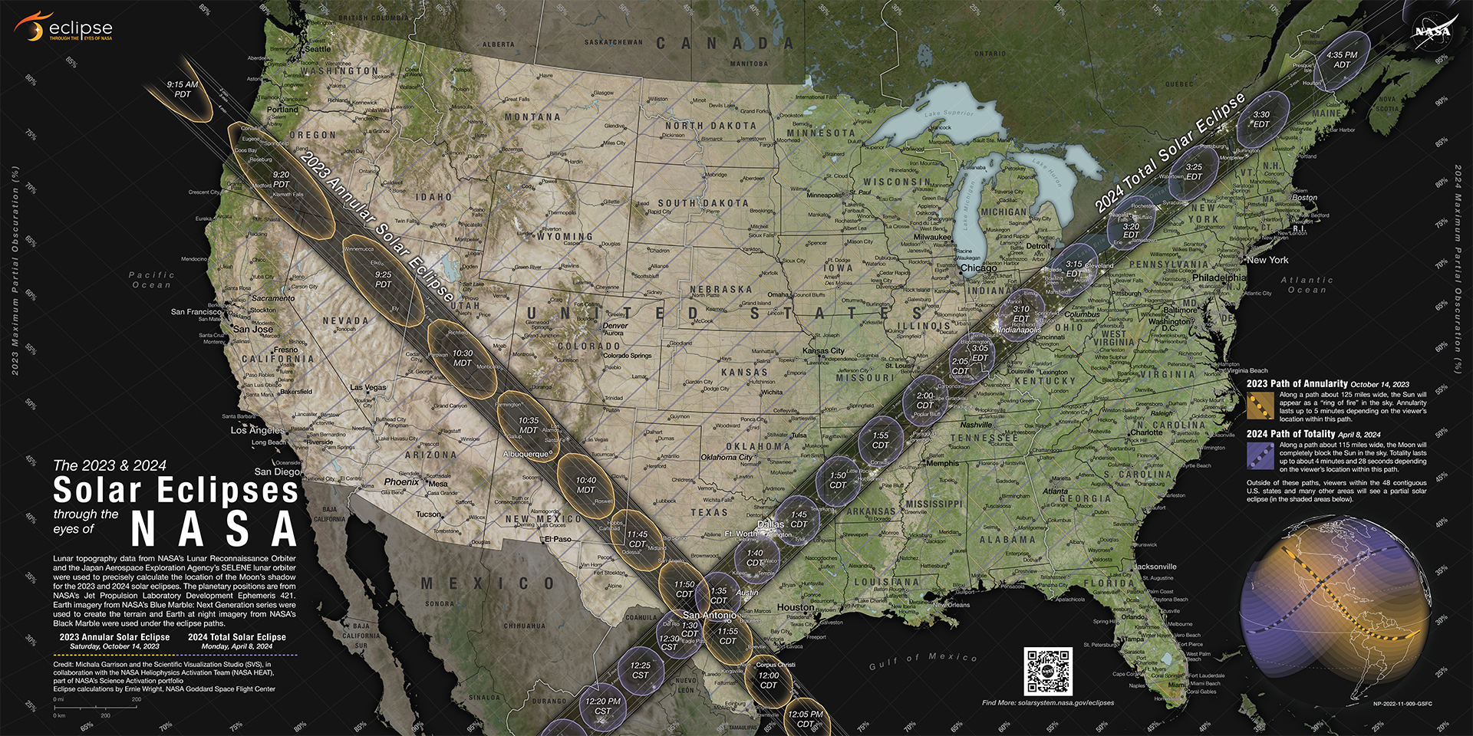
NASA Unique Map
2017

Slide 44
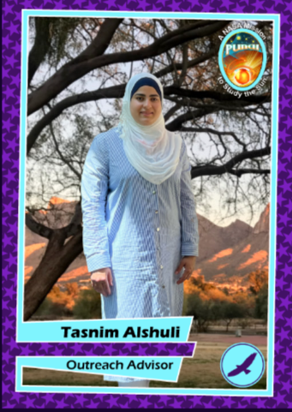
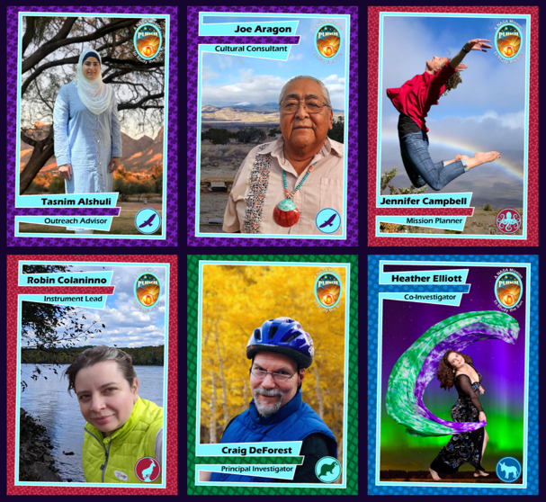
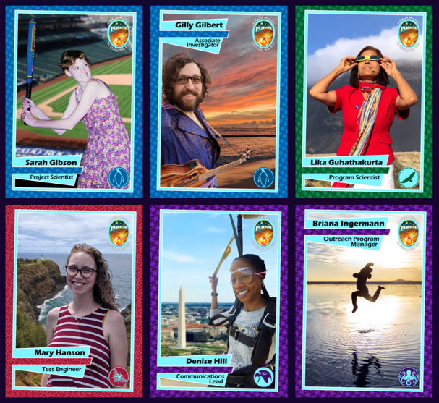
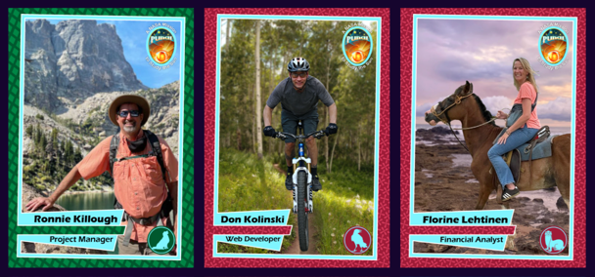
PUNCH Team Cards at NASA Booth
Inspired by Girl Scout partners
Valuable for all learners
NASA Space Science is for Everyone!
Morrow, Aubele, Aragon
11 Dec 2023 cherilynn.morrow@gmail.com
44
PUNCH Outreach: “No Target Audiences” for AGU Session ED12A (07)

Slide 45
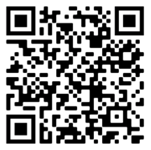
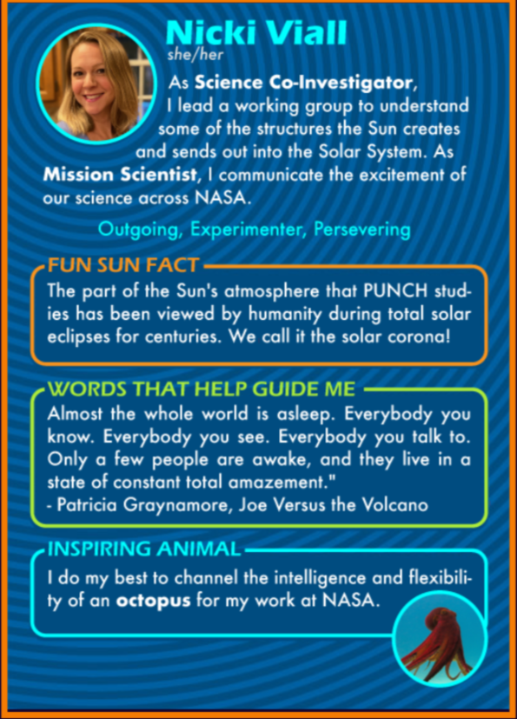
PUNCH Team Cards
Mission Scientist Nicki Viall
Morrow, Aubele, Aragon
11 Dec 2023 cherilynn.morrow@gmail.com
45
PUNCH Outreach: “No Target Audiences” for AGU Session ED12A (07)

Slide 46
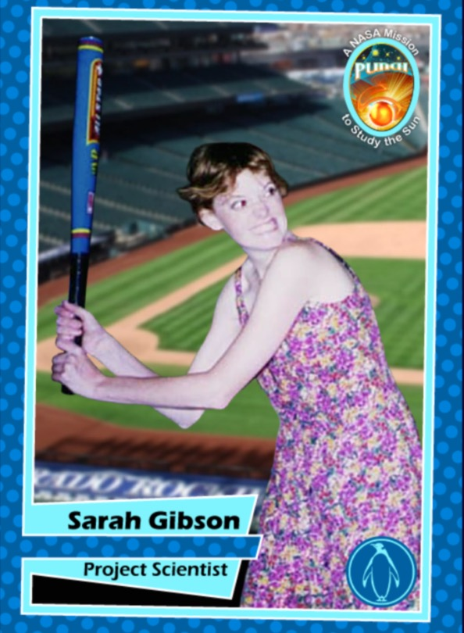
PUNCH Team Cards
PI and Project Scientist
Morrow, Aubele, Aragon
11 Dec 2023 cherilynn.morrow@gmail.com
46
PUNCH Outreach: “No Target Audiences” for AGU Session ED12A (07)

Slide 48
Sources and Credits
https://eclipsewise.com/
MrEclipse.com
https://space.fm/
Jamie Harold at Space Science Institute (eclipse 101)
Solar & Lunar Eclipses Worldwide (timeanddate.com)
Educator Guide: Moon Phases | NASA/JPL Edu
PUNCH: Outreach Pinhole Projector (swri.edu)
NASA SVS | Annular Eclipse Safety GIFs with Nicola Fox
Eclipses Home | Eclipses – NASA Solar System Exploration
https://science.nasa.gov/learn/heat/resource/annular-solar-eclipse-training/?annular_eclipse

