Slide 1
The Bathtub Game
Find more resources like this at STEMAZing.org
Notes:
The Bathtub Game is from The Climate Change Playbook by Dennis Meadows, Linda Booth Sweeney, and Gillian Martin Mehers.
You can find a printable worksheet for this activity here:

Slide 2
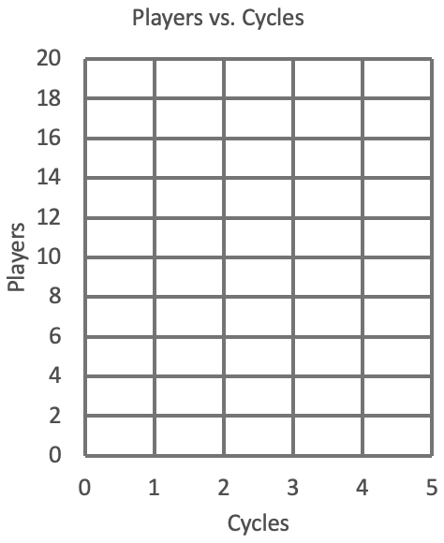
Draw this behavior-over-time graph on your whiteboard paddle.
Notes:
If you don’t want to take the time to have your students draw these graphs, you could use The Bathtub Game Worksheet found here:

Slide 3
Trial 1

Slide 4
Trial 1:
Start with 6 players in the stock.
Five cycles of:
Inflow: 2 players in.
Outflow: 0 players out.

Slide 5
Safety Slide

Slide 6
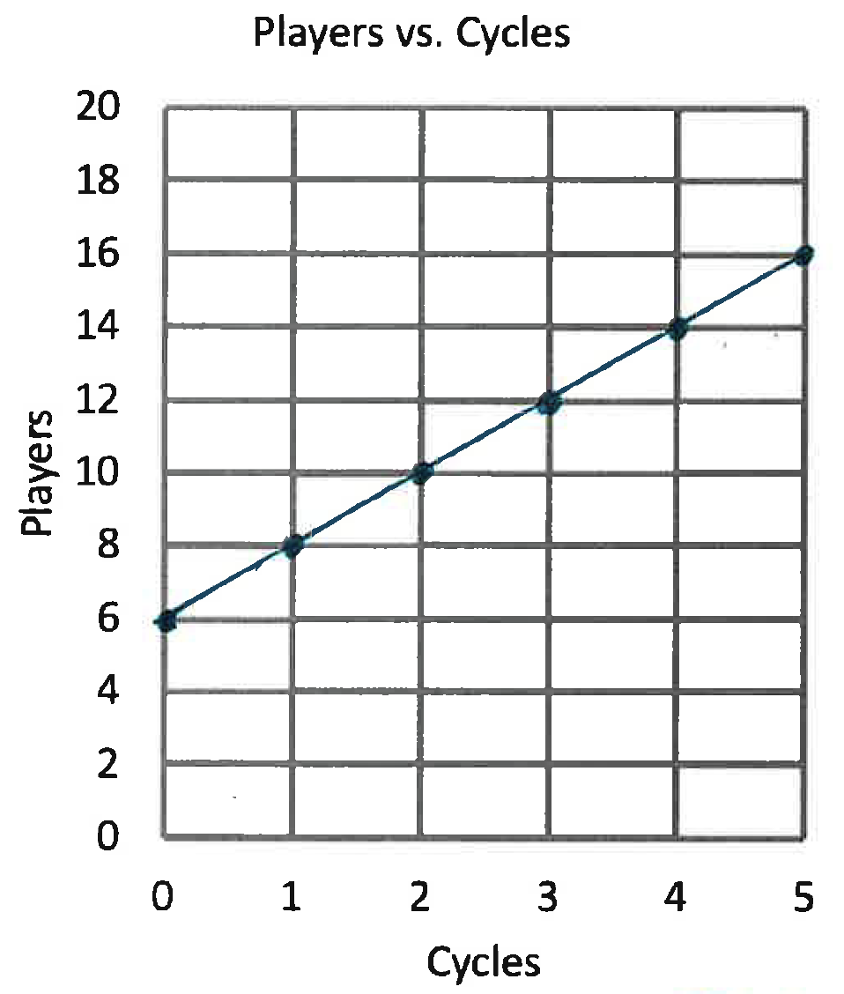
Trial 1:
Start with 6 players in the stock.
Five cycles of:
Inflow: 2 players in.
Outflow: 0 players out.
Lesson: If inflow is greater than outflow…

Slide 7
Trial 2

Slide 8
Trial 2:
Start with 6 players in the stock.
Two cycles of:
Inflow: 2 players in.
Outflow: 0 players out.
Three cycles of:
Inflow: 1 player in.
Outflow: 0 Players out.

Slide 9
Safety Slide

Slide 10
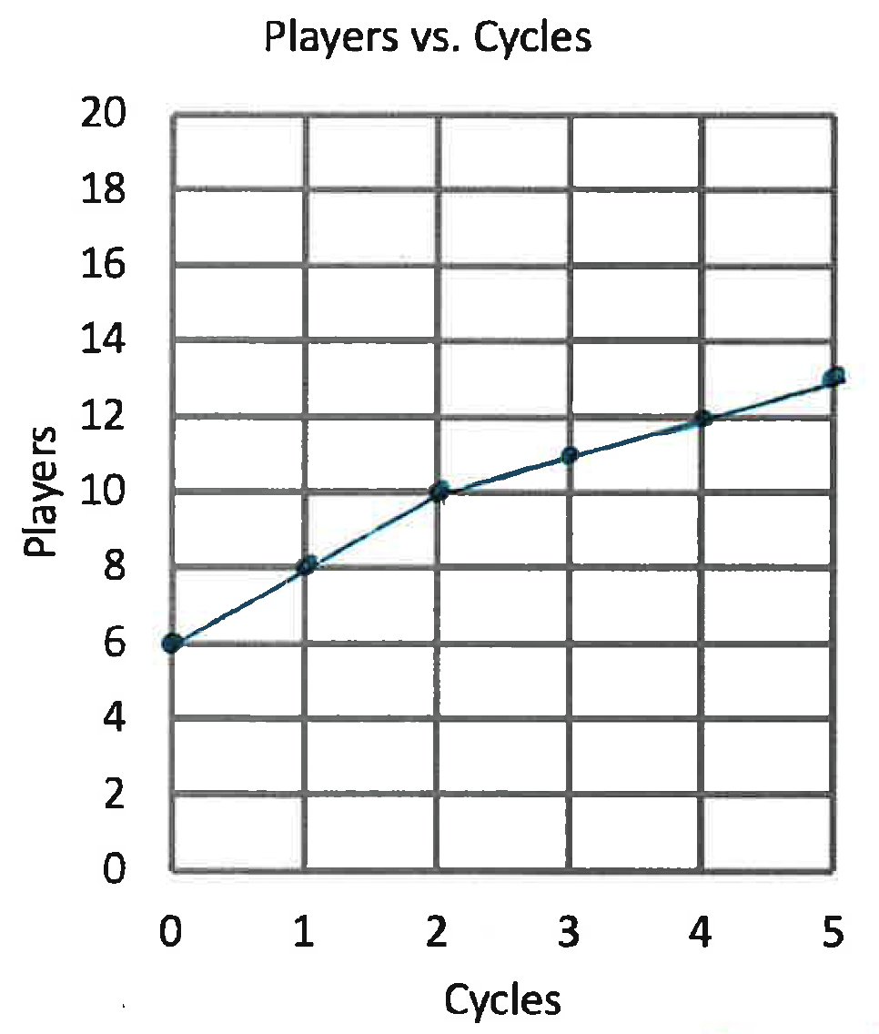
Trial 2:
Start with 6 players in the stock.
Two cycles of:
Inflow: 2 players in.
Outflow: 0 players out.
Three cycles of:
Inflow: 1 player in.
Outflow: 0 Players out.
Lesson: Even if inflow is made smaller, if the inflow is greater than the outflow…

Slide 11
Trial 3

Slide 12
Trial 3:
Start with 6 players in the stock.
Five cycles of:
Inflow: 2 players in.
Outflow: 2 players out.

Slide 13
Safety Slide

Slide 14
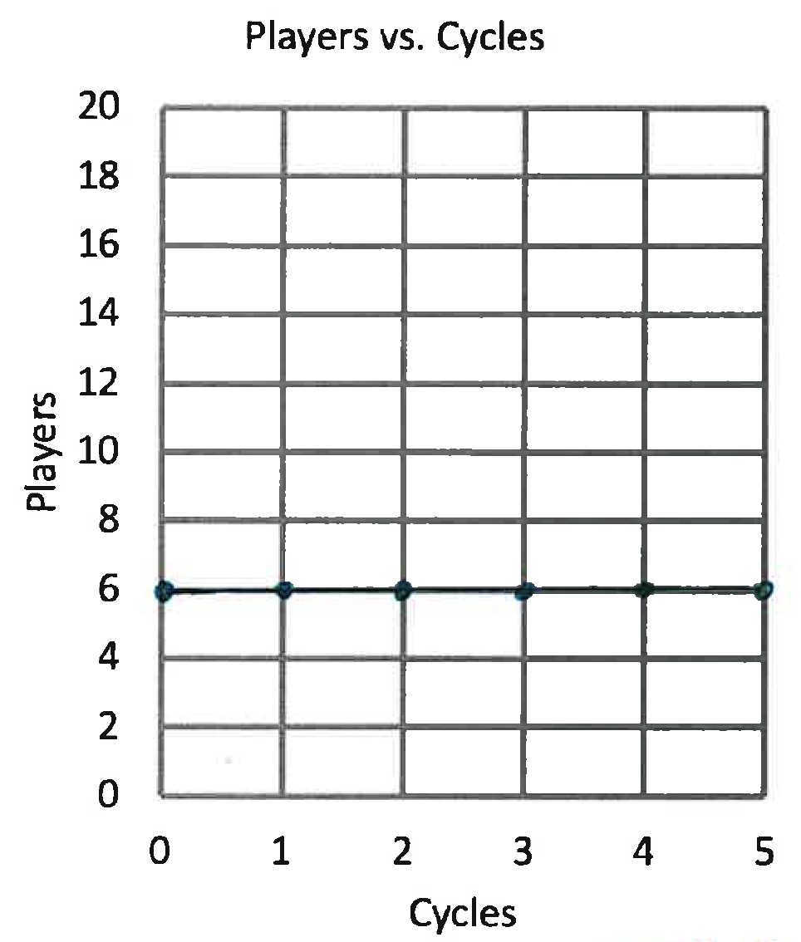
Trial 3:
Start with 6 players in the stock.
Five cycles of:
Inflow: 2 players in.
Outflow: 2 players out.
Lesson: If the inflow is the same as the outflow…

Slide 15
Trial 4

Slide 16
Trial 4:
Start with 6 players in the stock.
One cycle of:
Inflow: 5 players in.
Outflow: 1 player out.
One cycle of:
Inflow: 1 player in.
Outflow: 1 player out.
Three cycles of:
Inflow: 0 players in.
Outflow: 1 player out.

Slide 17
Safety Slide

Slide 18
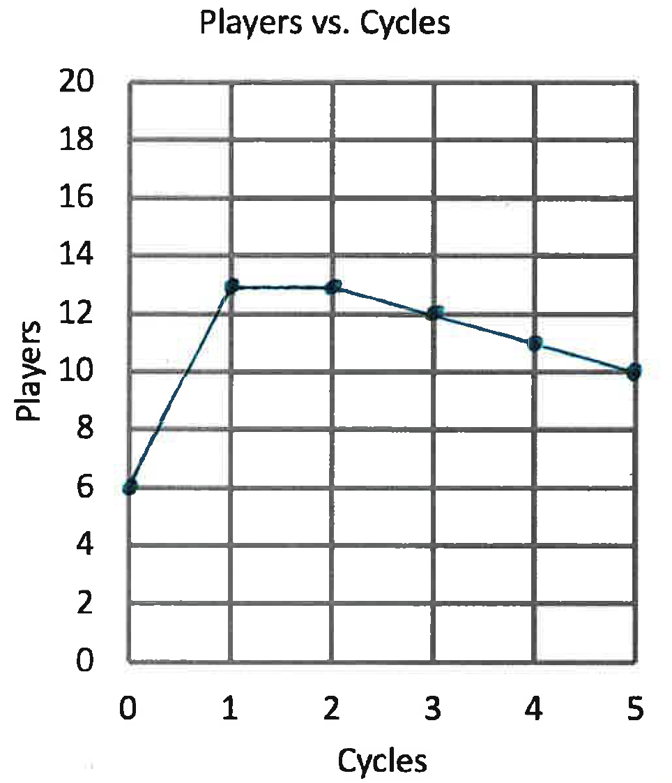
Trial 4:
Start with 6 players in the stock.
One cycle of:
Inflow: 5 players in.
Outflow: 1 player out.
One cycle of:
Inflow: 1 player in.
Outflow: 1 player out.
Three cycles of:
Inflow: 0 players in.
Outflow: 1 player out.
Lesson: Even if the inflow is less than the outflow…

