Slide 1
Session 1: Engineering
World’s Best Glider Using
IDEAS Engineering Journal
Notes:
Find detailed directions for this lesson here: https://stemazing.org/engineering-worlds-best-glider/

Slide 2
What do we know about engineers?
Engineering Activity
What is an engineer?
What are some of the different kinds of engineers?
How do engineers make the world a better place?
Materials Needed:
*Pair of scissors
*Two straws
* Five index cards
*Clear tape
Notes:
Engage students in
A great reference for learning more about the different kinds of engineers: https://tryengineering.org/students/engineering-computing-and-technology-fields/

Slide 3
What, Why, How
Experience using the IDEAS Engineering Journal to see how it helps guide you through the improvement of existing designs by engineering the world’s best glider.

Slide 4
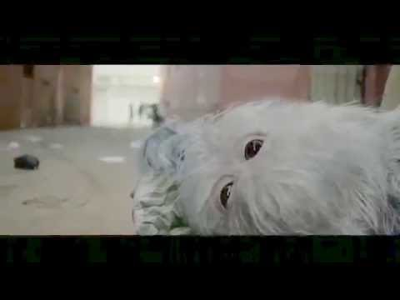
Notes:
Show this quick video for inspiration about fostering ideas.
Link to video in case it is needed: https://stemazing.org/ideas-are-scary-ge-commercial/

Slide 5
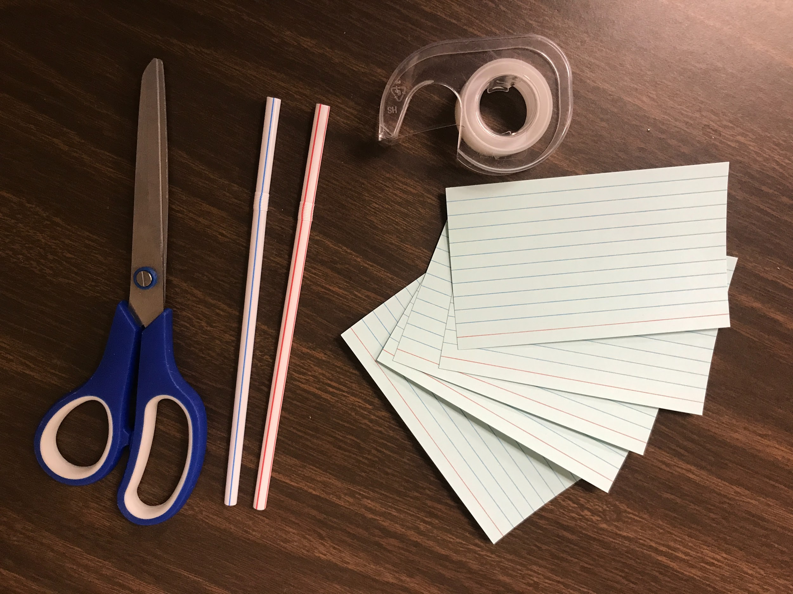
IDEAS Engineering Glider
Engineering Activity
Materials:
index cards
straws
tape
scissors
Pencil
IDEAS Engineering Journal
Materials Needed:
*Pair of scissors
*Two straws
* Five index cards
*Clear tape
Notes:
These are the supplies you will need to complete this project. Constraints (limits): You are only allowed to use straws, tape, and index cards for all of your glider designs.
You can print out the IDEAS Engineering Journal here: https://stemazing.org/ideas-engineering-journal/

Slide 6
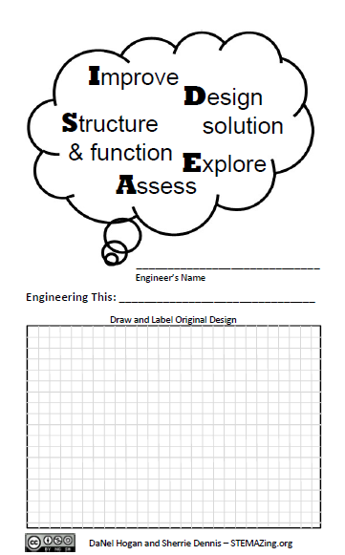
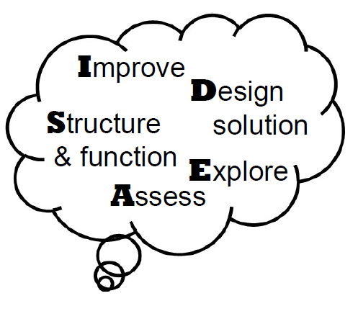
IDEAS Engineering Journal
Notes:
Add you name where it says Engineer’s Name and write “glider” on the Engineering This: line. Be sure to make a big deal about students becoming aerospace engineers for this part of the project.

Slide 7
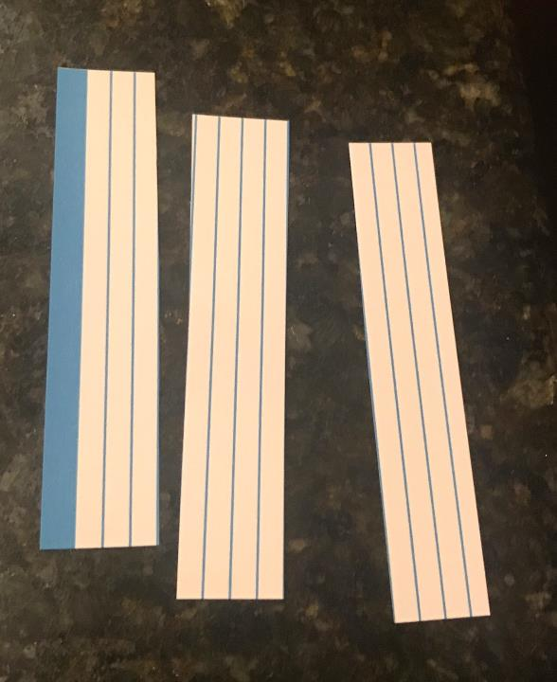
Notes:
Take a single index card and cut it into thirds. For lined index cards, this means cutting along every 4th line. If you count every 4th line and mark it with a pencil, this makes it easier to remember which line to cut. It is fine that all the sections are not exactly the same width due to printing inaccuracies of the index cards. They just need to be ⅓ ish.

Slide 8
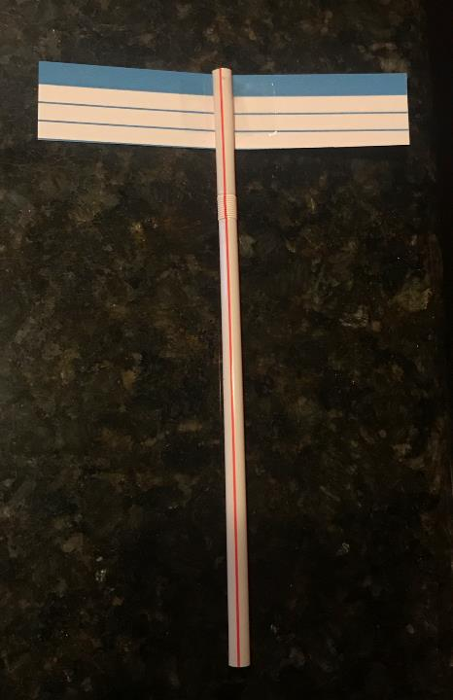
Notes:
Tape one of the ⅓ sections to the straw as shown.

Slide 9
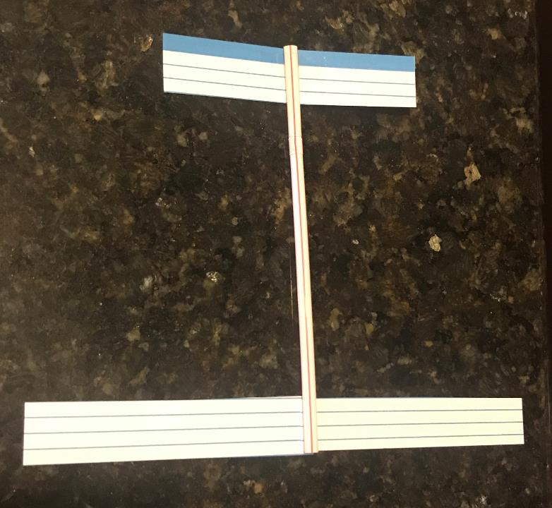
Notes:
Overlap the other two 1/3 sections of the index card and tape around them to hold them together. You should now have a double length strip. Then tape that section to the other end of the straw as shown.

Slide 10
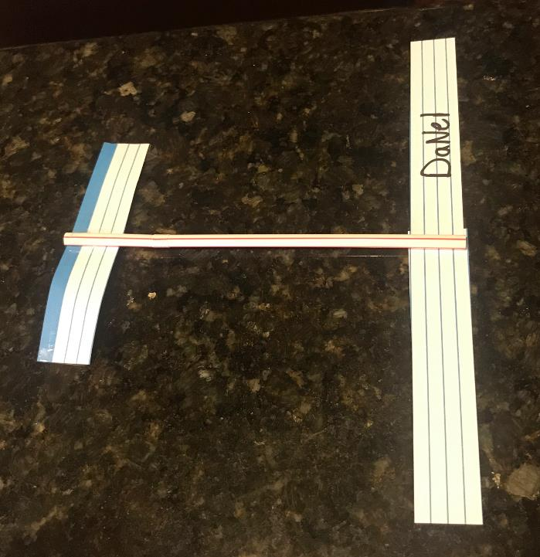
Prepare to be impressed.
Complete your labeled drawing and wait to test the glider until instructed to do so.
Notes:
Make your labeled drawing of the original design on the front of the IDEAS Engineering Journal. Really talk up how incredible this design is and how impressed you think they are going to be with it.

Slide 11
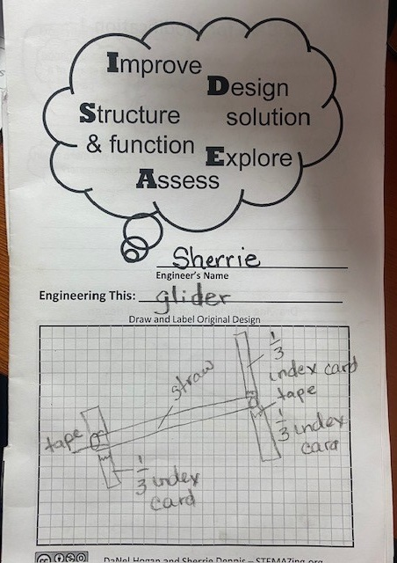
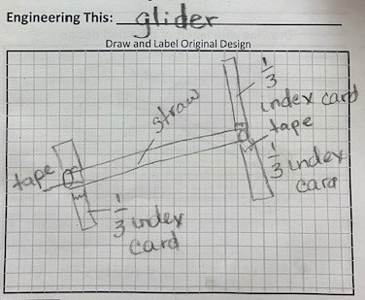
Original Design – Labeled Drawing
Notes:
Here is an example of a labeled drawing. Could someone make the glider the same way you did based on the drawing you have provided?

Slide 12
Test it!
Record observations in journals.
Share observations.
Notes:
Now you can test your glider.
They should fairly quickly notice that the gliders don’t fly all that well. Have them test them by launching them with either wing in the front – short and long. Usually one or two students will have one that is balanced just right and it flies well, but in general, they stall and fall to the ground. Have at least a quick discussion about how important it is to F.A.I.L. (first attempt in learning). Engineers are failures – that is how they learn and improve designs.
If there is time, referencing the failure theme in the #STEMAZingPictureBook Rosie Revere, Engineer by Andrea Beaty is great. From the book, after Rosie (a 2nd grader) has an engineering project fail her Aunt Rose says “Your brilliant first flop was a raging success! Come on, let’s get busy and on to the next!” And then Rosie realizes – Life might have its failures, but this was not it. The only true failure can come if you quit.

Slide 13
Modification 1
Notes:
Time for modification 1. Have students brainstorm some ideas we might change about the design based on these questions.

Slide 14
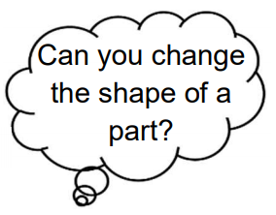
Modification 1
Ideas?
Notes:
As them for specific ideas about a part of the glider they might change the shape of. They should not make the modifications but should record them on the brainstorming lines between the questions and drawing space on page 1 in their journals.
Tell them that we are all going to make the same first modification but if they want to make one of the other modifications later, they will have a chance to come back to some of their other ideas.

Slide 15
Prepare to be impressed.
Complete your labeled drawing on page 1 in your journal and wait to test the glider until instructed to do so.
Notes:
Instruct students to overlap each strip about ¼” and tape them into place as loops, as shown above. They should again make a drawing in their journals and label the drawing on page 1. (If doing this in class, students should write their name on the wing before making it into a loop.)

Slide 16
Modification 1 - Labeled Diagram - Shape Change
Notes:
Everyone should make another detailed labeled drawing in their journals on page 1. Example of labeled drawing above.
Engineers should also describe the modification they made on the top of page 2 in their journals and write the teacher picked this modification for why they picked it.

Slide 17
Test it!
Record observations in journals.
Share observations.
Notes:
Engineers to fly the modified glider. They should try launching it small loop toward the front and large loop toward the front. After some time, they should share out what they noticed (their observational evidence) and record it in their journals. They should also circle how the performance was impacted by the modification.
This is a great opportunity to use non-standard measurement (heel-to-toe length measurement) to quantify some of their evidence.

Slide 18
Engineer it!
Continue making modifications to your glider and working through the IDEAS Engineering Journal. Be prepared to share your final designs at next session!
Notes:
Explain their assignment is to keep making modifications to the glider as they work through the IDEAS Engineering Journal filling it out with brainstorming, labeled drawings, descriptions, and evidence about glider performance as they go. Point out pages 7 and 13 in their journals that asked them to have someone use their glider after Modifications 3 & 5. This customer critique is meant to provide them with some feedback and additional ideas for modifications.
The goal before next session to try to make FIVE modifications and complete their journal.

Slide 19
Why engineer?
Where engineering might lead you?
Notes:
After engineers have had some time to try their gliders, then refocus them on why we need engineers. Then show video on next slide.

Slide 20
Notes:
After you play video, have a quick discussion with students about what they noticed and what they wonder about the video.
Link to video in case it is needed: https://stemazing.org/meet-molly-ge-commercial/

Slide 21
Continue engineering your world’s best glider. How far will it go?
Notes:
Here you can talk about constraints and criteria. The world’s best glider will be judged on the criteria that it flies the farthest. The constraints for this world’s best glider is that it can only be made using index cards, flexible straws, and tape. You could also have two categories if you wanted to – one category keeps with the strict constraints detailed, the other category can be constraint free or in other words, whatever supplies students have access to, they can use. This can lead to inequitable experiences for students, but not necessarily better gliders. This could be something you compare. If students don’t have measuring devices at home, they can use heal to toe measuring. And then you can have a discussion about non-standard units.

