Slide 1
Design Inspirations
Select two numbers and write them in the chat.
Must be between 1-15, including 1 and 15.
Can be the same.
Need paper and writing utensil.

Slide 2
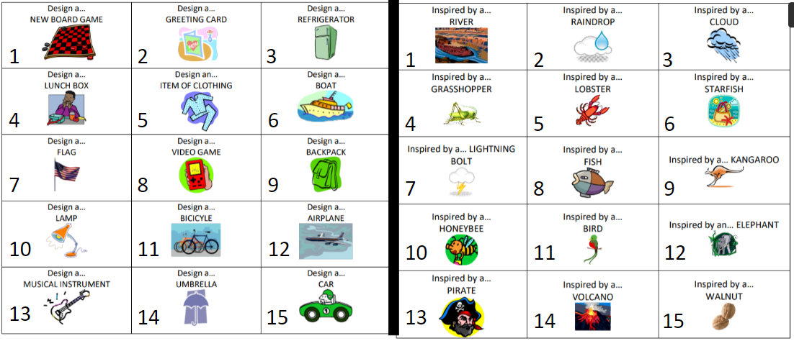
Design Inspirations

