Slide 1
The Habitable Zone (HZ)
What makes a planet habitable?
In astronomy we define the HZ as the region around a star where a planet can support liquid water at its surface

Slide 2
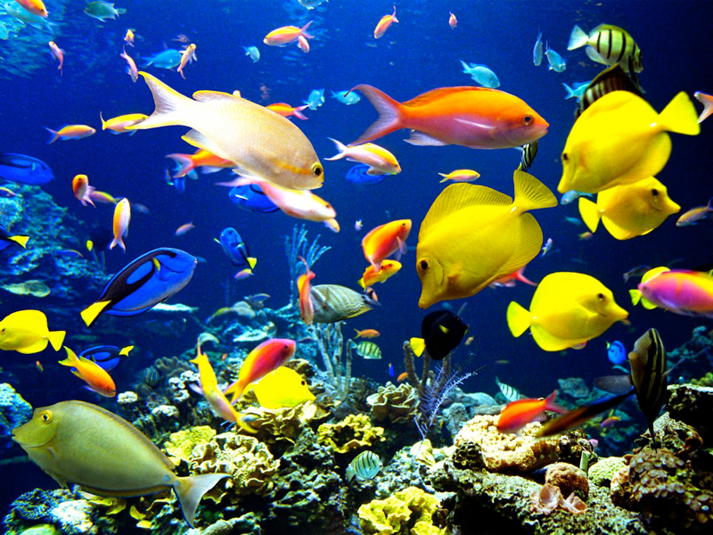
Notes:
Earth is the one planet we know of w/ liquid water on the surface (as well as a range of other environments)

Slide 3
What factors influence surface habitability?

Slide 4
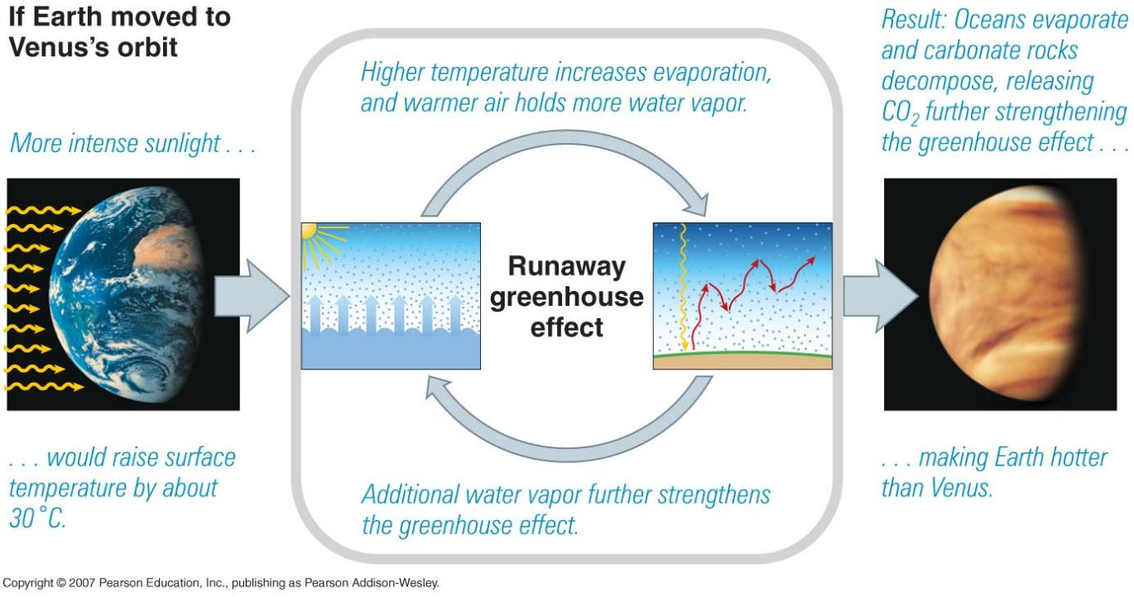
1. Distance from the central star
Imagine moving Earth from1AU to ~0.7AU (Venus location) from the Sun…

Slide 5
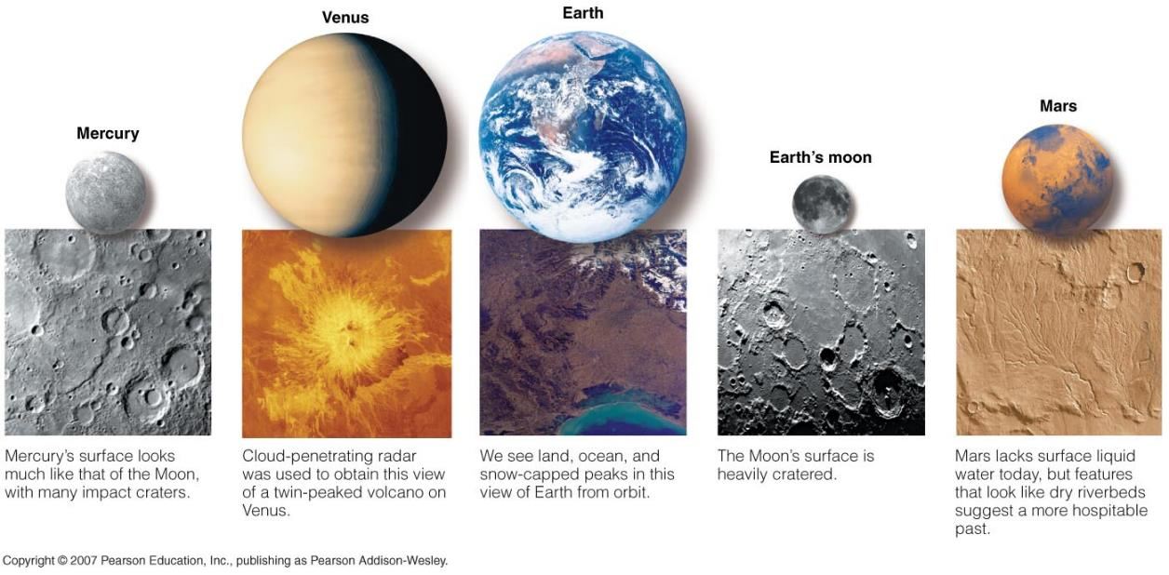
1. Distance from the central star
2. Planet’s size
Why is Mars so cold?
All planets form hot.
Mar’s interior cooled quickly due to small size ➔ lost magnetic field ➔ lost atmosphere
Notes:
Without a magnet field the atmosphere was exposed to the solar wind (energized particles from the sun) and the atmosphere was stripped away

Slide 6
1. Distance from the central star
2. Planet’s size (> Mars)
Plate tectonics – CO2 cycle– climate regulation
runaway greenhouse ➔ lost water ➔ crust too stiff for plate tectonics (due to distance from Sun)
cooled too fast ➔ lithosphere thickened (few broken plates)
Notes:
Venus is slightly smaller than Earth
Plate tectonics on Earth allow for exchange of carbon between the atmosphere, ocean, and magma beneath the surface

Slide 7
1. Distance from the central star
2. Planet’s size (> Mars)
3. Planet’s atmosphere
i) atmospheric pressure to keep water liquid
ii) protect against the UV radiation from the Sun

Slide 8
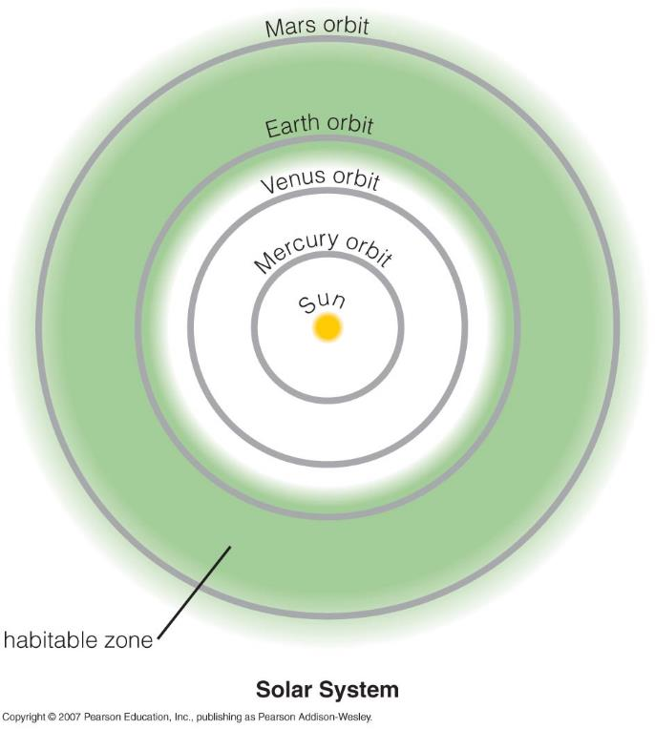
The Habitable Zone (HZ)
Take a planet similar to Earth and change its distance from the Sun: at which distances would the planet still be habitable (i.e. has abundant liquid water on its surface)?

Slide 9
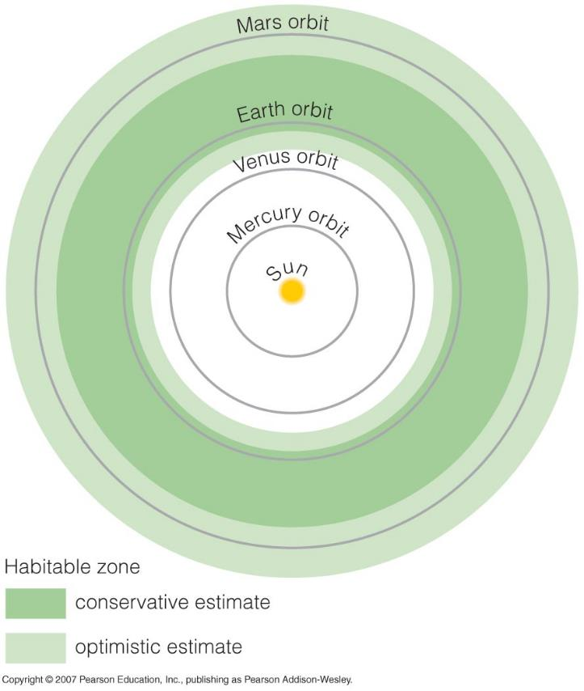
Boundaries of the Habitable Zone Today
Outer boundary:
Even very strong greenhouse effect could not
keep the planetary surface warm enough to
allow liquid water
Inner boundary:
Any closer and the planet would undergo
a runaway greenhouse effect
NOTE: Venus is NOT in the HZ, Mars is in the HZ in the optimistic scenario!

Slide 10
Why would the location of the HZ change with time?
Stars change brightness with time (over Gyrs).
Note that the Sun was ~30% less bright ~3Gyr ago than it is today!
How would you expect the HZ to change with time?

Slide 11
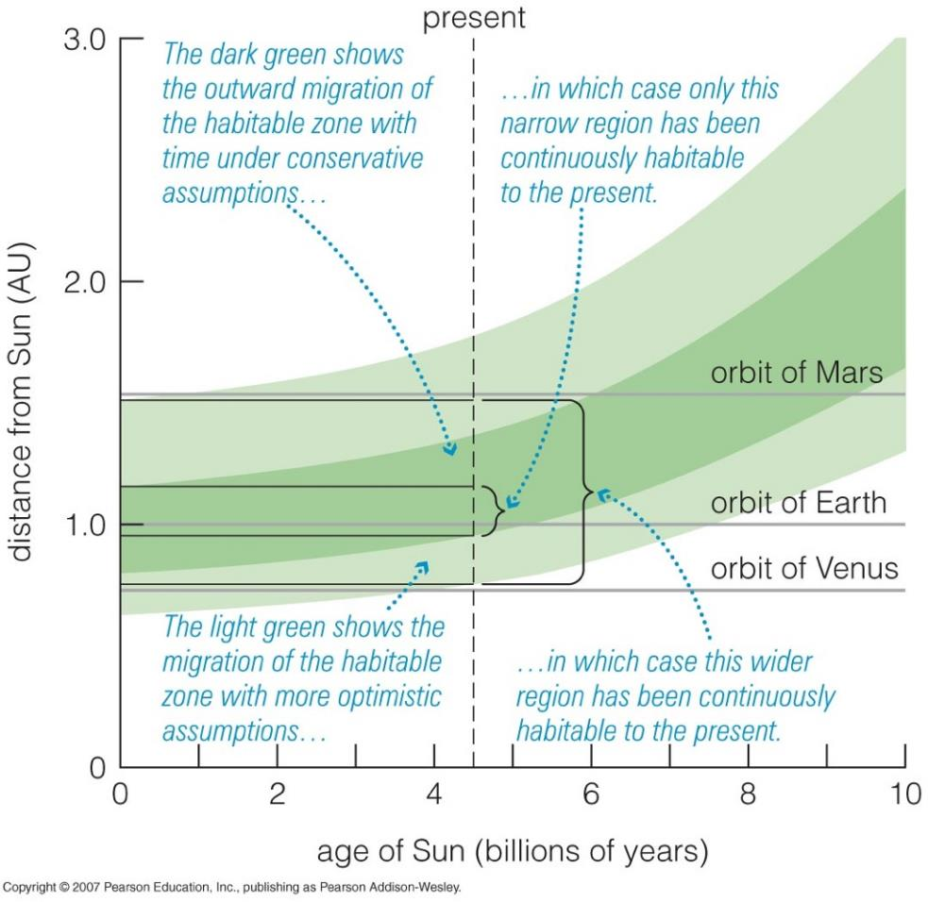
The Evolving HZ
the Sun becomes brighter with time
Venus was in the HZ
Mars will be in the HZ (even pessimistic case)
Earth will be out of the HZ in ~1Gyr

Slide 12
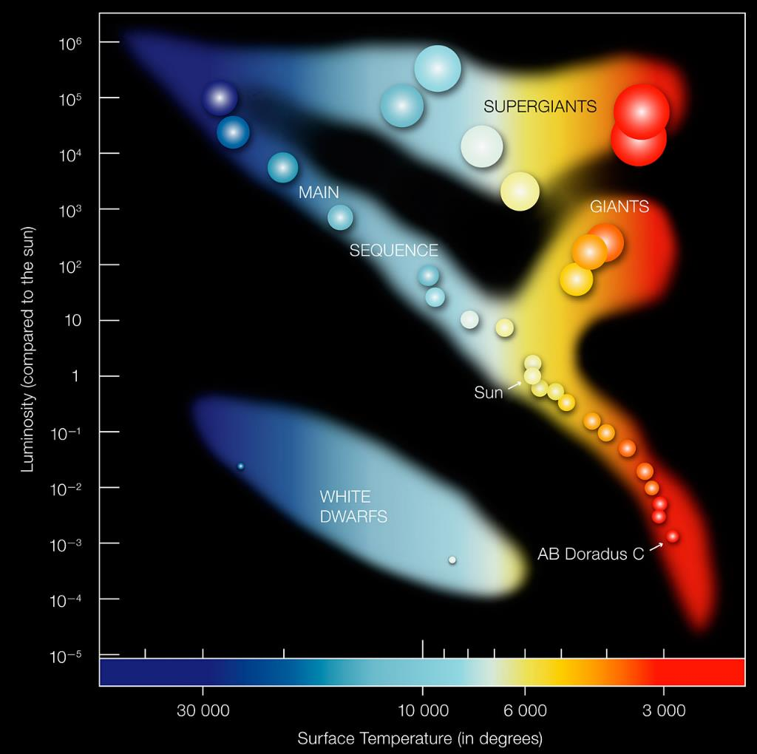
Note: Small stars in the main sequence are cooler and less luminous. What is the implication for their HZ?
Luminosity (compared to the Sun)
Surface Temperature (in degrees C)
Credit: ESO
Notes:
Hertzsprung-Russel Diagram
Luminosity is intrinsic brightness
Stars spend most of their time at a single location on the main sequence
Note temperature on x axis increases to the left

Slide 13
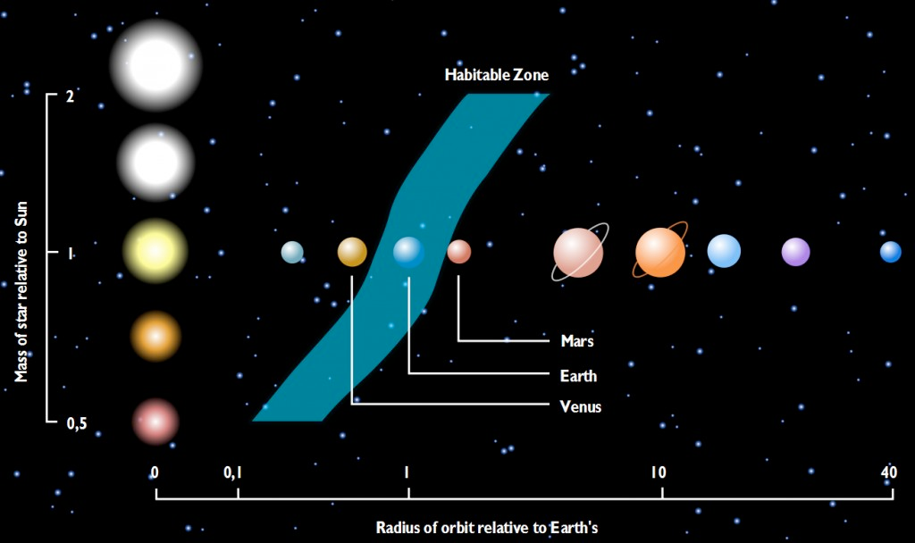
NOTE: a) smaller stars have a HZ that is closer in
b) smaller stars have a HZ that is narrower
(Log scale)
Notes:
On the main sequence higher mass stars are brighter -> habitable zone is farther out
Note x axis is logrhythmic

Slide 14
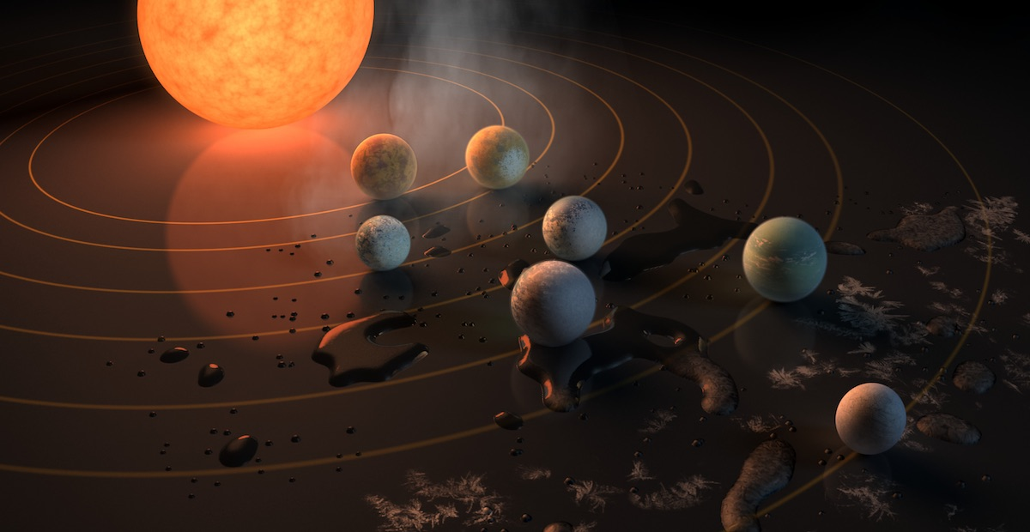
TRAPPIST-1: nearby (~40ly) planetary system around a small star with ~3-4 planets in the HZ
Credit: TRAPPIST team

Slide 15
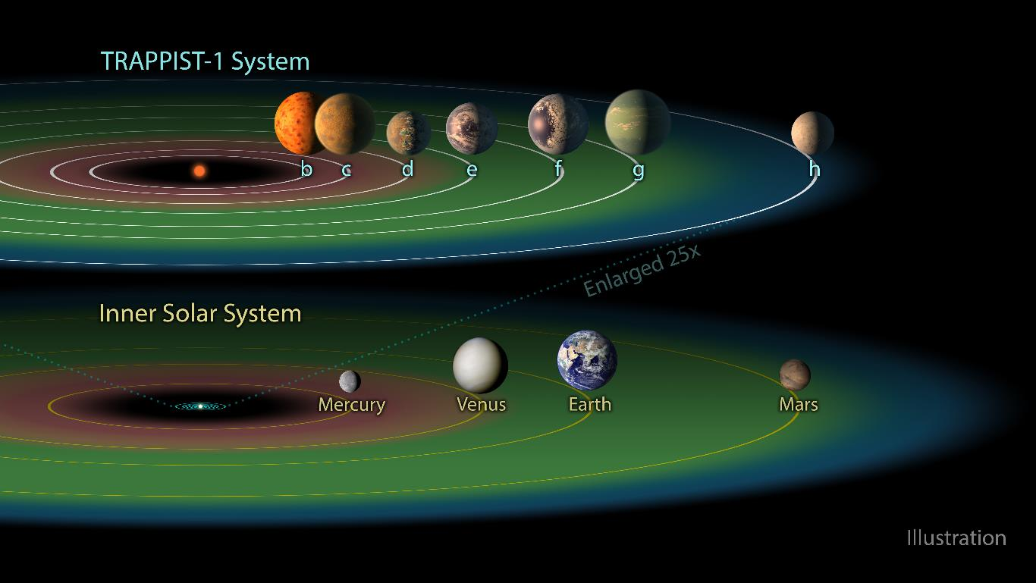
Notes:
https://cdn.spacetelescope.org/archives/images/large/heic1802d.jpg
Likely 3 planets in the HZ (e,f,g)

Slide 16
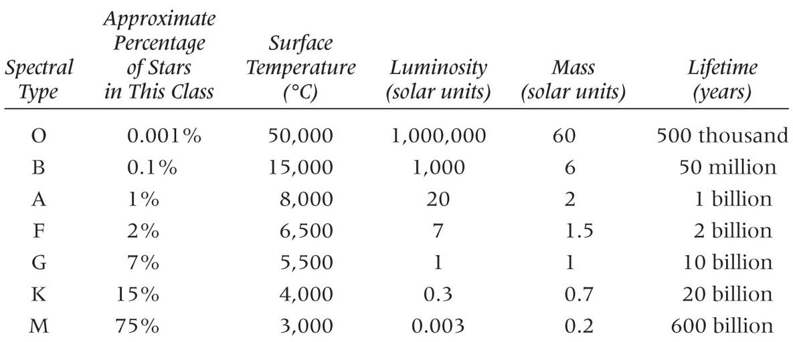
However small stars (M dwarfs) are attractive because:
They are numerous! (75% of the stars in the solar neighborhood are small, ~0.2xthe mass of the Sun)
They live long! (more than 10x longer than stars like our sun)
Notes:
The Sun is spectral type G

Slide 17
Credit: NASA/Kepler
Credit: NASA/Kepler
Notes:
Size of circle is related to size of planet. Most Habitable zone planets found by Kepler are larger than Earth and unlikely to actually be habitable

Slide 18
The bottom line...
The Habitable Zone is the region around a star where a planet can support liquid water at its surface
Not all Habitable Zone planets look like Earth
Not all Habitable Zone planets are habitable
what’s next?
We have some examples of HZ planets: In the next few years we want to find even more & determine if they are habitable

Slide 19
How can we detect life on other planets?
Kepler planets are not good for follow-up studies (too far away), we need to identify closer planets in the HZ
TESS!
We are not going to ‘see’ life (indirect methods)
Notes:
TESS, like Kepler, uses the transit method to detect planets, focusing on nearby stars
All exoplanets are too far away and too small to resolve.

Slide 20
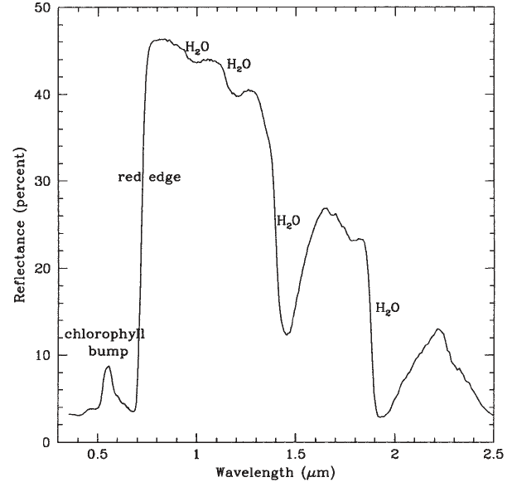
Possible biosignature in planet’s atmospheres
Vegetation red-edge
(N. Woolf, UofA)
Need mission at optical/near-IR wavelengths
reflection spectrum of a leaf
Optical
Infrared
Notes:
Spectrum of Earth’s atmosphere taking from Earth light reflecting off the Moon
Can see evidence of life, namely ozone and water absorption lines as well as the vegetation red-edge, a feature caused by light reflecting off of green plants on the planet’s surface
http://www.spaceref.com/news/viewpr.html?pid=7055
http://hoffman.cm.utexas.edu/courses/rededgedetectingvegetation.pdf

Slide 21
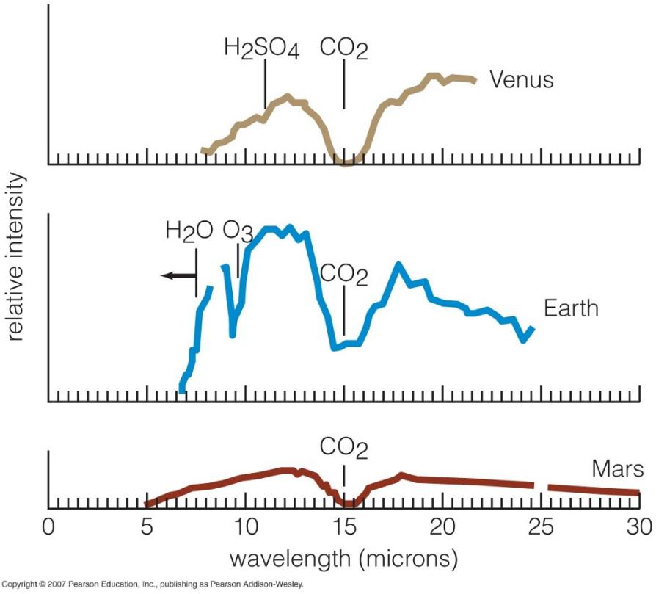
Possible biosignature in planet’s atmospheres
ozone/oxygen (current Earth) OR methane (early Earth)
Need mission at IR wavelengths
Notes:
CO2 is a strong feature in the atmosphere but is not a sign of life. Instead need O3, which is produced by living organisms

Slide 22
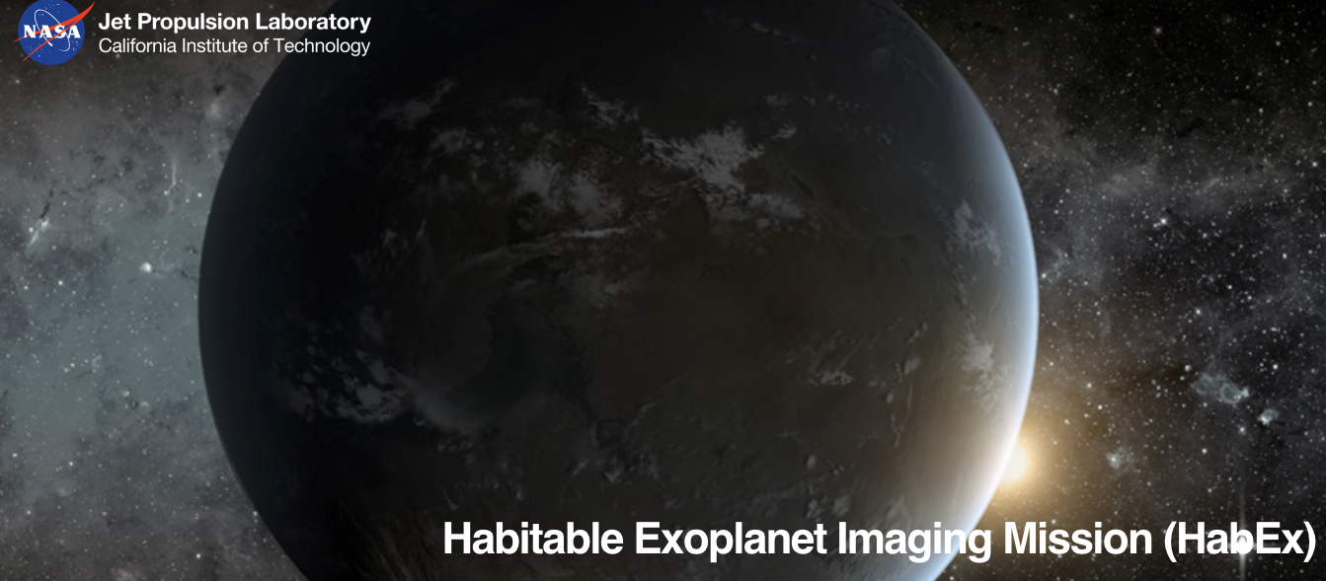
Future NASA missions (?) to detect biosignatures
Notes:
Four next generation missions have been proposed for launch in the 2030’s. Only one will be funded.

Slide 23
Activity: Finding the habitable zone

