Slide 1

Perplexing Parallel
Paper Circuits

Slide 2
LED – Light Emitting Diode
Take out circuit supplies.
  Bag with copper tape, battery, binder clip, and five different colored LEDs.
Remove ONLY the battery and the red LED.
Explore the conditions needed to light up the red LED.
What do you notice? What do you wonder?
Notes:
Students should notice that one lead (leg) of LED is shorter than the other.
Students should notice that the LED will only light if it is connected with the short lead on the back of the battery and the long lead on the front of the battery (the side with writing on it).
You can then let them in on the fact that LEDs are directional. The short lead is the negative lead and the long lead is the positive lead.

Slide 3
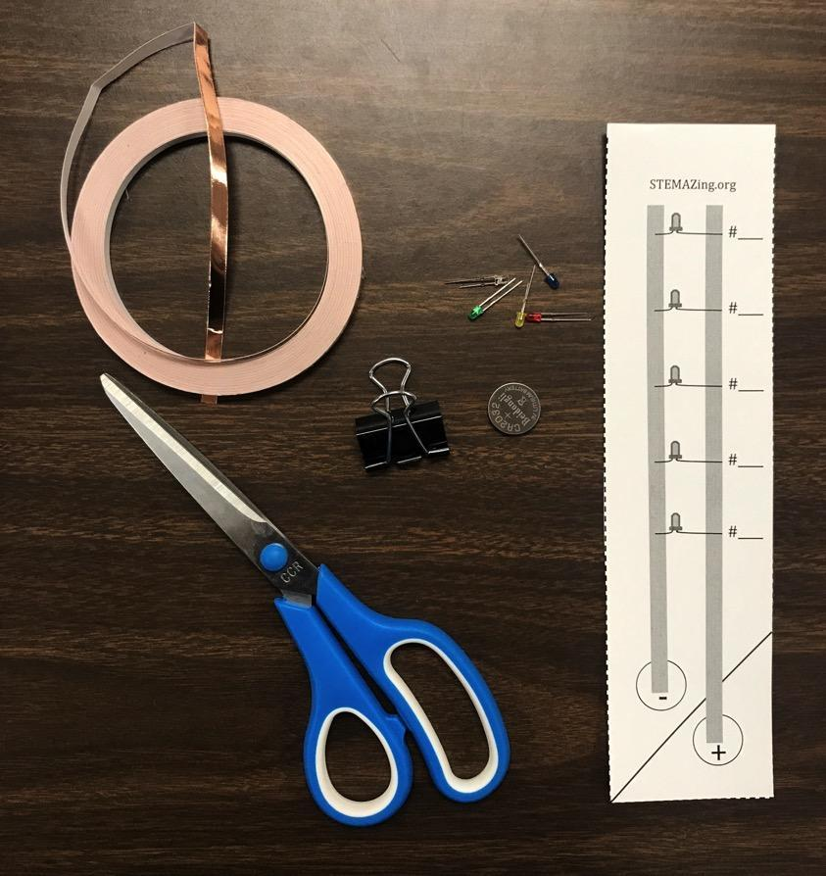
Supplies
meter of copper tape
2032 battery button
circuit template
medium binder clip
5 colored LEDs
  red
  green
  blue
  yellow
  white
Notes:
Double check supplies.
The circuit template can be found in the lesson here: https://stemazing.org/perplexing-parallel-paper-circuit/

Slide 4
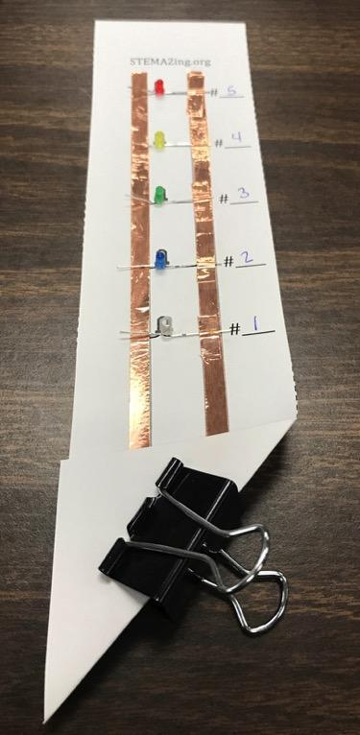
Nature of Science Paper Circuit
Notes:
Quick view of final product but note that the order of the LEDs is not important. You might even tell the students they will get to decide which order they put their LEDs in on their circuits.

Slide 5
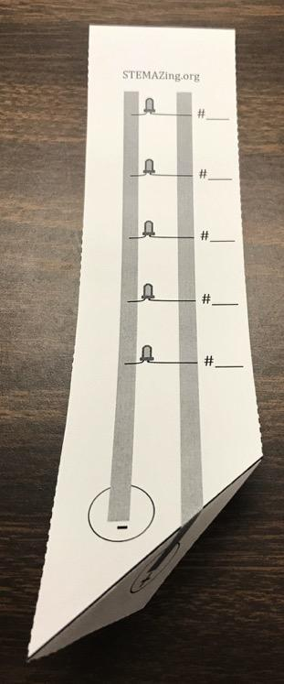
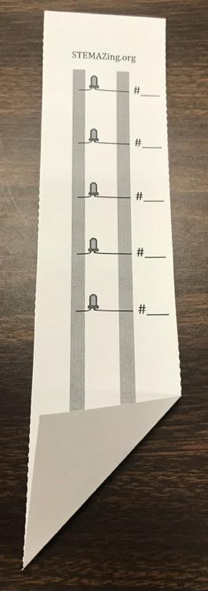
Fold back, then forward
Notes:
Prep the template by folding it first backward along the diagonal line so you can see where to fold and then folding it forward.

Slide 6
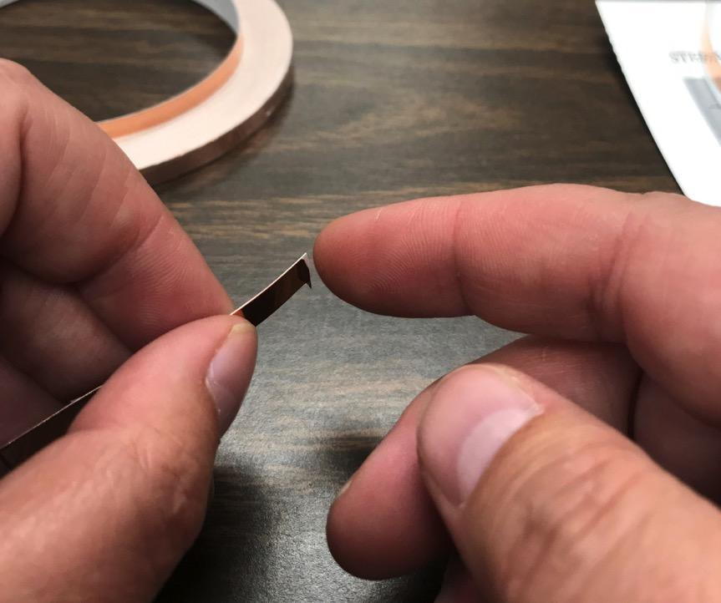
Getting copper tape started
Notes:
The best way to separate the copper tape from the backing is to rub your finger gently across the end or corder to get it started.

Slide 7
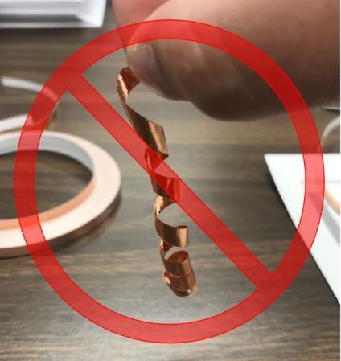
Avoid curlicues
Notes:
Demonstrate that ripping the tape off the backing all at once with make it curl and generally makes it useless because you can’t untangle it. They should get it started and then slowly pull off the backing as they stick it to their template as shown on the next slide.

Slide 8
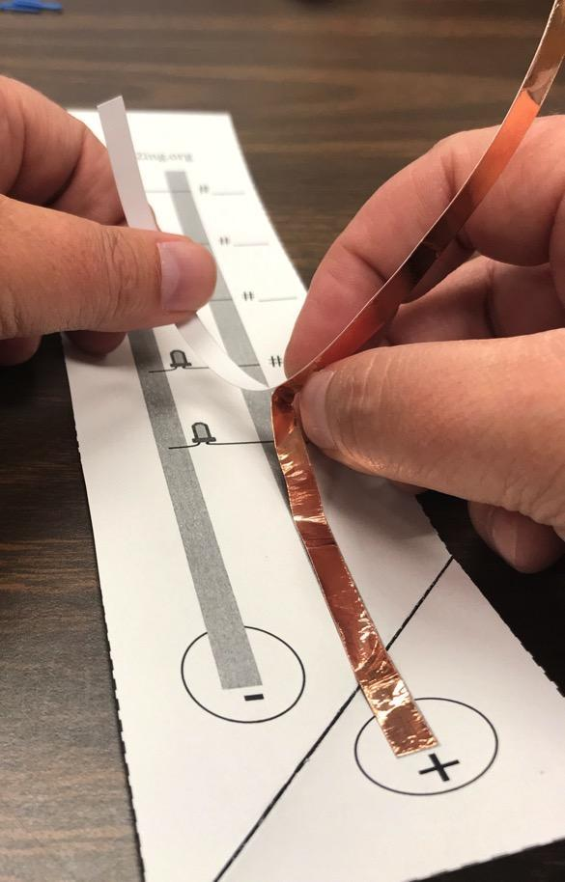
Add first lead
Notes:
Students should measure and cut or tear a piece of copper tape to the correct length for the first lead in their circuit. They should then get the end starting to separate and carefully put the tape in place along the template. It needs to be lined up -ish. It doesn’t not need to be exactly perfect but the closer to the template line the better.

Slide 9
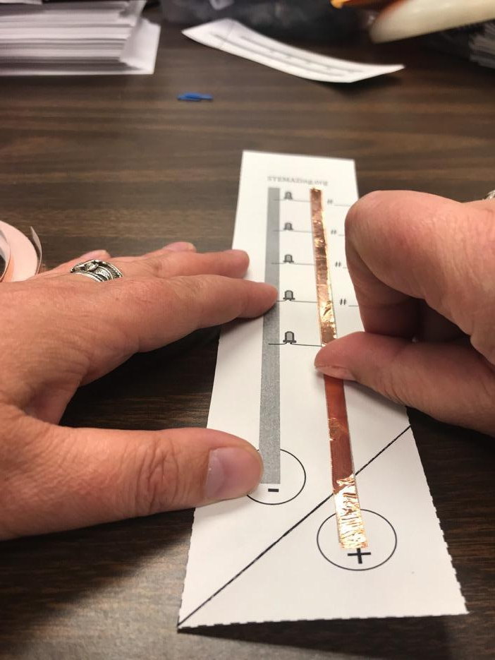
Secure lead
Notes:
Students can better secure the tape by rubbing the side of the thumbnail gently along the copper tape to make sure it is really stuck to the template and smooth it out.

Slide 10
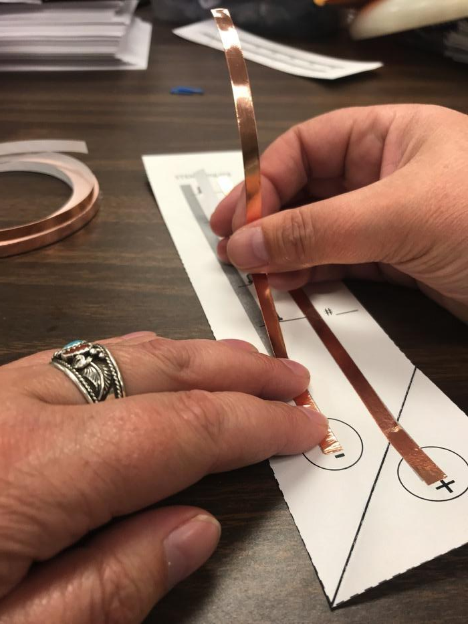
Add 2nd lead
Notes:
Repeat the steps for the 2nd lead - measure, cut or tear, add the lead, and then secure it with thumbnail.

Slide 11
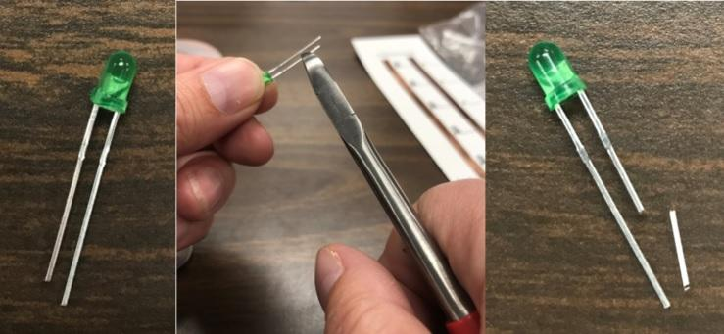
LED prep
Notes:
It is highly recommended that teachers prep the LEDs by doing this step in advance. Basically you want to cut off about ⅛” from the short negative lead. You can use either wire cutters or scissors (but not your Mom’s good fabric scissors). This way, when the students spread the leads out, like on the next slide, it will be really obviously which lead is the short negative lead and which is the long positive lead. You can have students do this step but there is a chance they cut both leads and potentially render one of the LEDs useless.

Slide 12
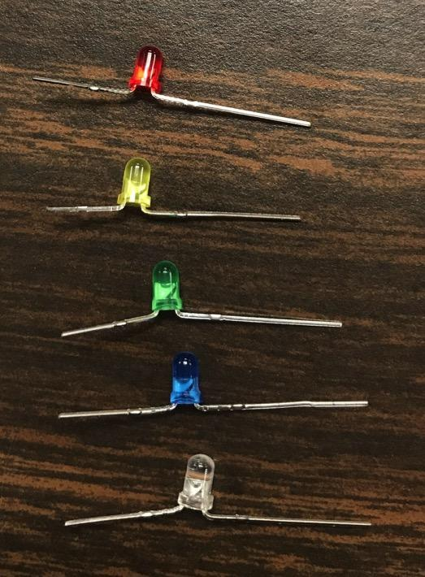
Spread LED leads
Notes:
Students should spread the two leads out in opposite directions on each LED as shown.

Slide 13
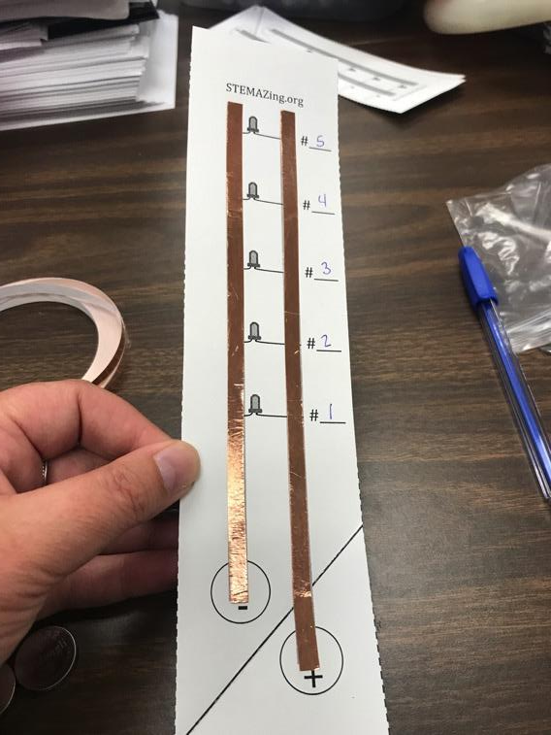
Number LED positions
Notes:
Everyone needs to number the spaces the same way. In the picture, it shows #1 closest to the battery and #5 furthest away. You can also start with #1 furthest away and number in with 5 closest to the battery. Again, it is just important everyone agrees to do it the same way so we can make the same comparisons. This also really gets them thinking the order is going to matter.

Slide 14
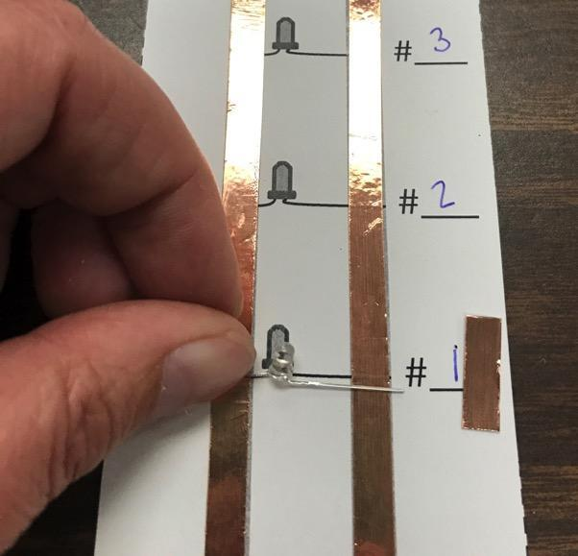
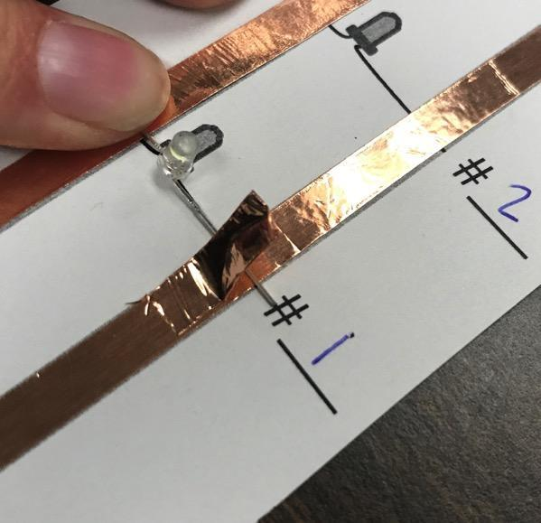
Secure LED in position #1
Notes:
Next students should tape down their first LED in the #1 position. It is important to tell them again that the order doesn’t matter. While it shows a white LED here, they can start with whichever color they want. They should use about ½” of copper tape to sandwich ONLY the positive long lead to the right copper lead of their circuit. They are not securing the negative short lead because they will be using that side as a switch to either close (push down and connect) the circuit or leave the circuit open (have the lead bent up away from the negative copper lead). This is shown in the next slide.

Slide 15
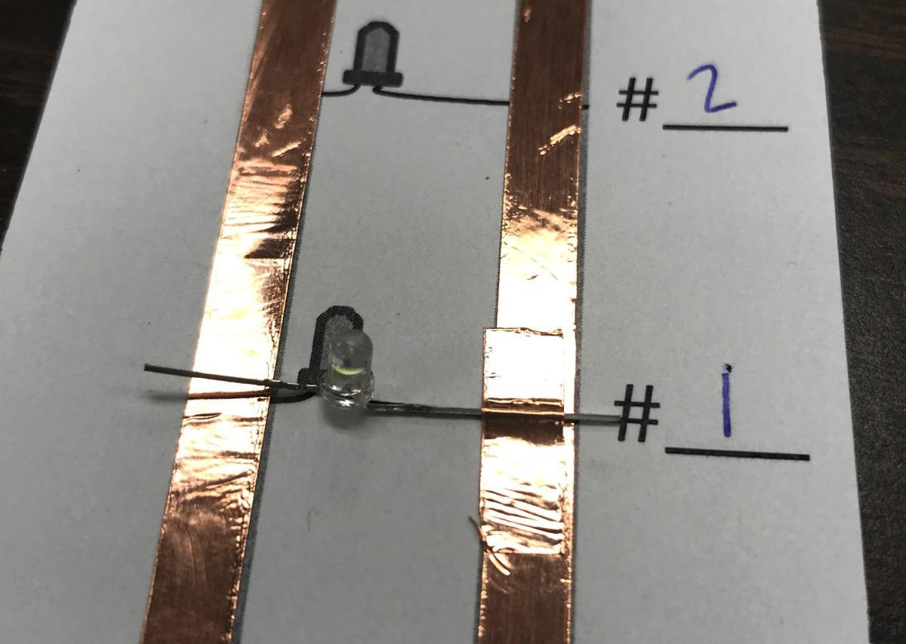
Notes:
This slide shows the secured long positive lead on the right and the negative lead bent up way from the negative lead of the copper tape so the circuit is open and not lighting up the LED.

Slide 16
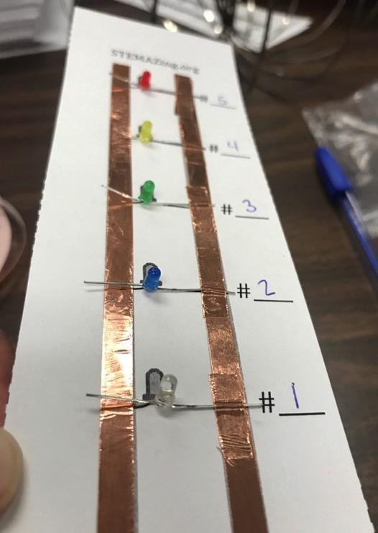
Secure the other LEDs
Notes:
They should secure all the other LEDs in the same way and in whatever order they want. Tape down the long positive leads on the right and bend up the short negative leads on the left so they can be used as switches to close the circuit or leave it open.

Slide 17
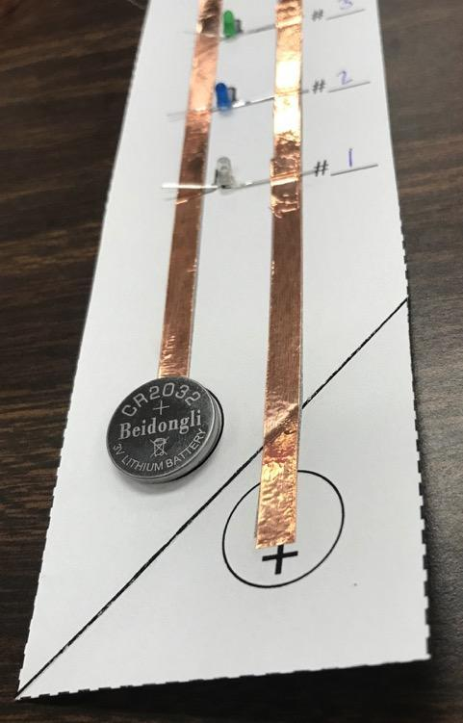

Install battery and secure
Notes:
Install the battery as shown and secure it with a medium binder clip as shown.

Slide 18
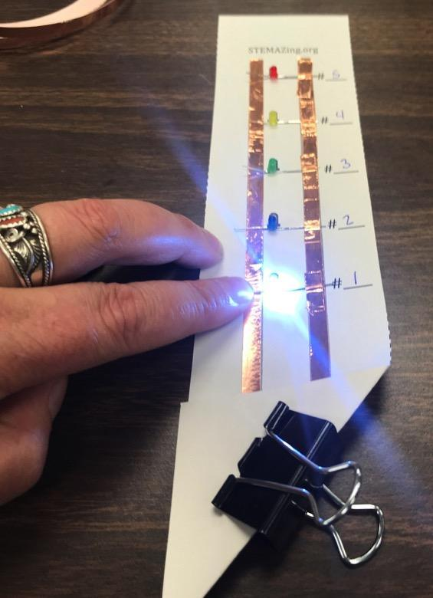
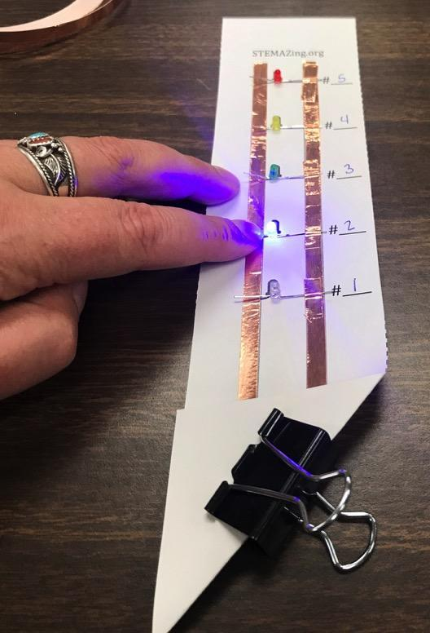
Test individual LEDs
Notes:
If any of the LEDs are lighting while the circuit is just sitting on the table or desk, students should bend the negative short lead up a bit more so all the circuits are open. Then, one at a time, they should push down on the negative leads to close the circuit and make sure each LED will light up. If one is not working, they should really push down on the copper tape securing the positive lead to the copper tape on the right. They might even use the side of their thumbnail to make sure it is a really good connection. If nothing works, they should take the LED out and test it with the battery. Make sure the LED works and that the positive lead is secured on the right and the negative lead is being used as a switch on the left. Once all the LEDs are working individually, then it is time to play to figure out the rules. Leading questions on the next slide.

Slide 19
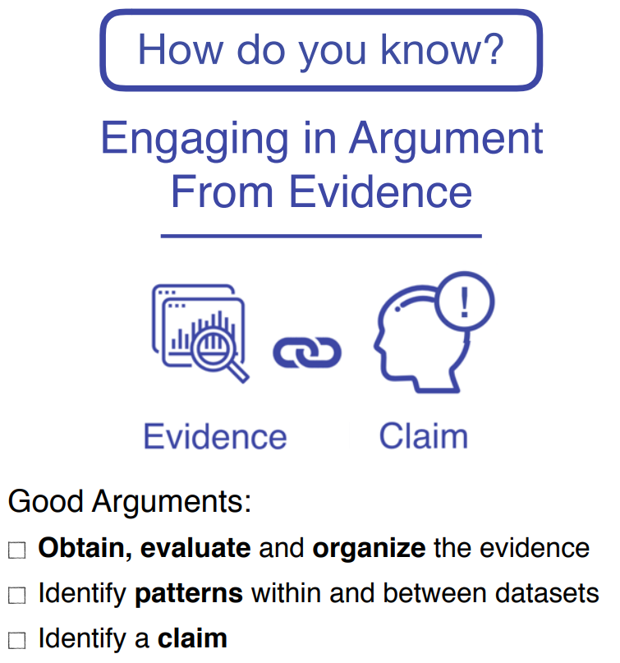
Figure out the rules
Which LEDs will light together?
Which LEDs will not light together?
How many LEDs can be lit up at the same time?
Write down your rules (claims). We will discuss them once everyone has had a chance to play.
  Claim with evidence (experiment you tried)…
Notes:
Students should try to figure out and record the rules they think the LEDs follow. They are specifically using the “engaging in argument from evidence” science practice. You might repost these questions on a slide you push out to students as a background on https://whiteboard.fi/ - then students can record the rules they notice on their individual whiteboards. You can then save their whiteboards to give them credit for participating. Do not mention the importance of either order of the LEDs or color. Just give them these simple leading questions. They will generally make claims based on the order based on how you set up the circuit which is what you want. After students have had a chance to play for a while and record some rules they think the LEDs follow, you can either use their whiteboards or have them share out one rule at a time. You should then ask if others noticed the same thing or saw something different. For instance, one student might say - “#1 and #2 light up together because when I close both those circuits both LEDs light up.” If another student doesn’t say that didn’t work on their circuit, have them all test it. Say - “Let’s test this claim and see if it holds true for all our circuits.” Then someone should say it doesn’t work on theirs - only one of the two light up. Don’t give it away yet. Still have others claim rules and have everyone test them. Then, if a student makes the connection that it might be color, you can start to ask about rules related to color. And then eventually get to the real rules as found here: https://stemazing.org/nature-of-science-paper-circuit/

Slide 20
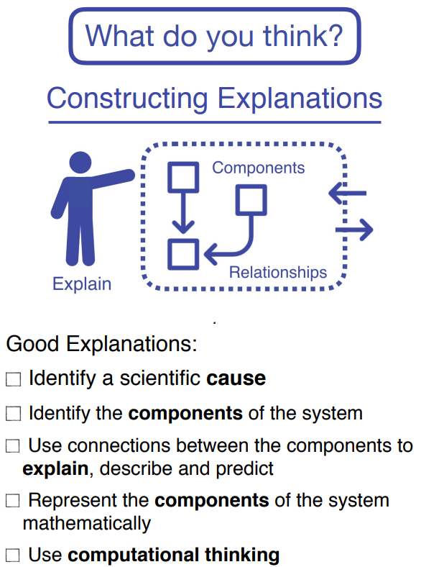
Claim, Evidence, Reasoning
Notes:
If you want to go further you can have students add reasoning to the claims they have based on the evidence related to color. The reasoning is the scientific explanation for WHY the LEDs behave the way they do. Can students identify a scientific cause for what they observed in the experiment? You can explain that this is the next step in making sense of the world - try to explain the why using scientific reasoning.

Slide 21
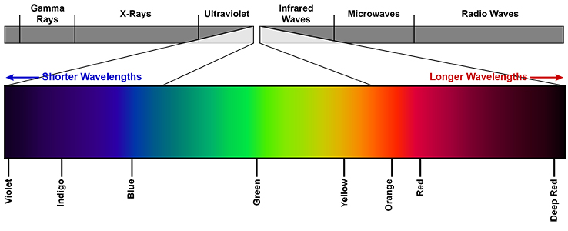
Claim, Evidence, Reasoning
What is the order of the visible spectrum (the same as the order of the colors in a rainbow)?
Visible Spectrum
Red
Orange
Yellow
Green
Blue
Indigo
Violet
Notes:
Use this slide to help students remember the order of the visible spectrum, which a rainbow demonstrates. Red, Orange, Yellow, Green, Blue, Indigo, and Violet (or purple) also remembered using the acronym ROY G. BIV.

Slide 22
Claim, Evidence, Reasoning
Visible Spectrum
Red
Orange
Yellow
Green
Blue
Indigo
Violet
LED Voltage Ratings
Red – 1.8-2.2 V
Yellow – 1.8-2.2 V
Green – 2.8-3.2 V
Blue – 2.8-3.2 V
White – 2.8-3.2 V
Notes:
Now that we have the order of the spectrum, share also the LED voltage ratings. Either in small groups or as a class, students should notice and wonder about how this information might help them give a scientific reason for why the LEDs behave the way they do. They should notice the red and yellow LEDs work together and have the same voltage ratings. The green, blue, and white LEDs work together and have the same voltage ratings. So, an explanation for the claims (rules) they made, based on the observational data from their experiments (trying different combinations of lights together), is that LEDs with the same voltage ratings will light up together and if LEDs have different voltage ratings, only the LEDs with the lower rating will light up. NOTE: This does not explain the weirdness we see with the green LED lighting up slightly with the red and yellow. You have to go further with the next slide of info to get to that. You could stop here and skip to the last slide or allow students to try to explain more.

Slide 23
Claim, Evidence, Reasoning
LED Voltage Ratings
Red – 1.8-2.2 V
Yellow – 1.8-2.2 V
Green – 2.8-3.2 V
Blue – 2.8-3.2 V
White – 2.8-3.2 V
Photon Energy
Red: 1.65-2.00 eV
Yellow: 2.10-2.17 eV
Green: 2.17-2.50 eV
Blue: 2.50-2.75 eV
White: combo of all colors
Notes:
Now, with the information about the energy of the photons based on color, students might notice that it also matches the order of the visible spectrum - red has the lowest energy then yellow is higher, green higher, and blue the highest energy. Note that eV is a unit called an electron volt. It is not truly important that they know more about this unit other than it is a unit used to measure energy. Using this information, students might make the following CER - The green LED lights up a little bit when connected with the red and/or yellow LED as seen when you close the green, red, and yellow circuits because green light has just slightly higher energy than the red and yellow. This is a bit of a leap for younger students but also provides more information for older students.

Slide 24
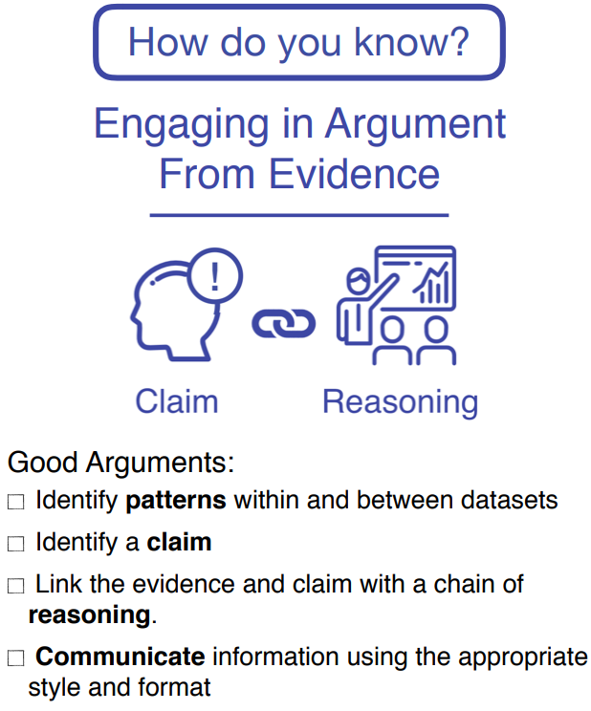
What about an orange LED?
What rules would it follow and why?
Can you predict its voltage?
What would its photon energy be?
Notes:
A pHun extension is to ask students how an orange LED would behave in the circuit system they have? What would it do? Which LEDs would it light with and which ones would it not work with? What would its voltage be? What would its photon energy be? (Or cut this question out if you didn’t use the photon energy slide.) After they have made predictions and defended their prediction using claims, based on the evidence and reasoning they used to explain the circuit, give them an orange LED to add to their circuit system to try it out! Where they right? How did it behave? You can later share with them that the voltage rating is 1.8-2.2 V for the orange LED and orange photons have the following energy: 2.00-2.10 eV. While students can look up these values, predicting how it will behave in the circuit will be completely based on their understanding of the rules they made and where they think the orange LED will fit in. Once they make predictions, you should not ever confirm the “right answer”. They should satisfy their curiosity and make sense of the world by doing what scientists do - test it!

