Slide 1
Binary #MicDropMath Patterns
Created by DaNel Hogan - @TheSTEMAZingPro – STEMAZing.org

Slide 2
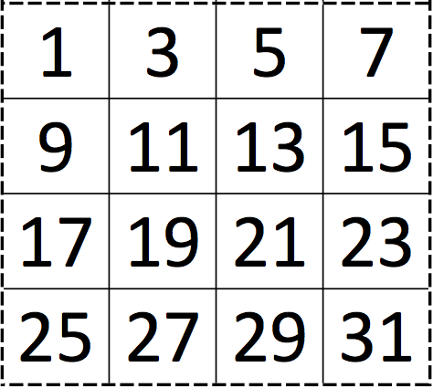
What patterns do you see?
Find binary number lessons and printable here: https://stemazing.org/binary-mic-drop-math-patterns/

Slide 3
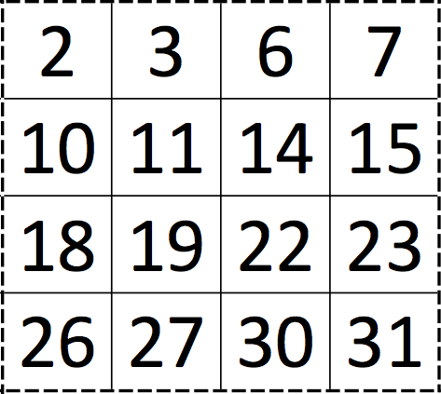
What patterns do you see?
Find binary number lessons and printable here: https://stemazing.org/binary-mic-drop-math-patterns/

Slide 4
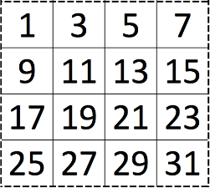
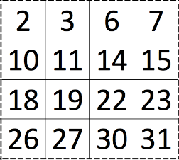
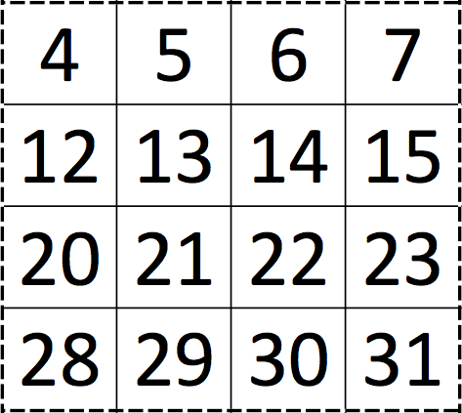
What patterns do you see?
Find binary number lessons and printable here: https://stemazing.org/binary-mic-drop-math-patterns/

Slide 5
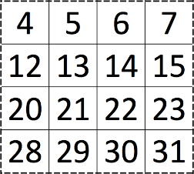
What will the next card start with?
Misconception – make a single hypothesis! NOPE.
Come up with every possibility you can support with a mathematical pattern.
Find binary number lessons and printable here: https://stemazing.org/binary-mic-drop-math-patterns/

Slide 6
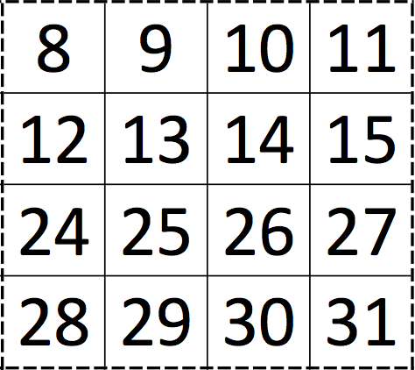
Did you have a hypothesis to support this? What do you think the next card will start with?
Find binary number lessons and printable here: https://stemazing.org/binary-mic-drop-math-patterns/

Slide 7
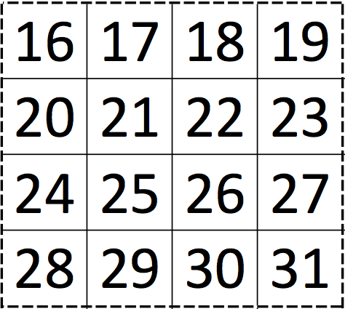
The importance of collecting more data!
Find binary number lessons and printable here: https://stemazing.org/binary-mic-drop-math-patterns/

Slide 8
Yes or No – number for just the day you were born?
Find binary number lessons and printable here: https://stemazing.org/binary-mic-drop-math-patterns/

