Slide 1
Habits of a Systems Thinker
Image Sort
Notes:
The Habits of a Systems Thinker image sort template (in both English and Spanish) can be found here: https://thinkingtoolsstudio.waterscenterst.org/resources/habits-sort/downloads

Slide 2
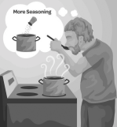
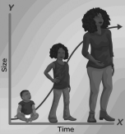
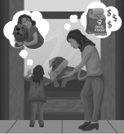
Notes:
The Habits of a Systems Thinker image sort template (in both English and Spanish) can be found here: https://thinkingtoolsstudio.waterscenterst.org/resources/habits-sort/downloads

Slide 3
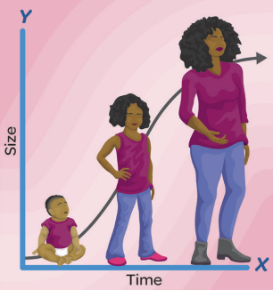
Notes:
The Habits of a Systems Thinker image sort template (in both English and Spanish) can be found here: https://thinkingtoolsstudio.waterscenterst.org/resources/habits-sort/downloads

Slide 4
Habits of a Systems Thinker
REVEAL
Notes:
The Habits of a Systems Thinker image sort template (in both English and Spanish) can be found here: https://thinkingtoolsstudio.waterscenterst.org/resources/habits-sort/downloads

Slide 5
Safety Slide
Notes:
The Habits of a Systems Thinker image sort template (in both English and Spanish) can be found here: https://thinkingtoolsstudio.waterscenterst.org/resources/habits-sort/downloads

Slide 6
Notes:
The Habits of a Systems Thinker: Single Page Version can be found here:
https://thinkingtoolsstudio.waterscenterst.org/resources/habits-single-page/downloads

